Slide 1
The results of the VMC/VEX photometry
at small phase angles:
glory and the properties of the upper clouds of Venus
W.J. Markiewicz, E.V. Petrova, O.S. Shalygina,
M. Almeida, D.V. Titov, S.S. Limaye, N.I. Ignatiev, T. Roatsch, and K.D. Matz
Solar System Symposium (3M-S³)
Moscow, October 2012

Slide 2
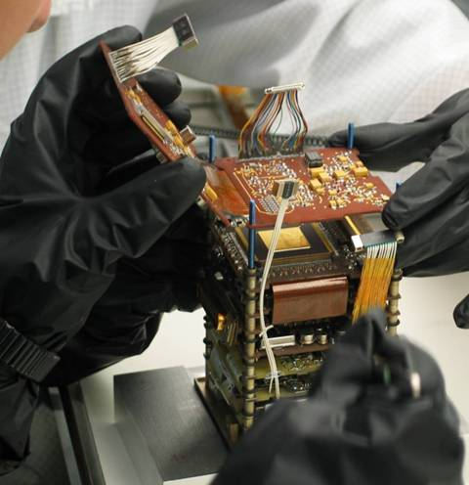
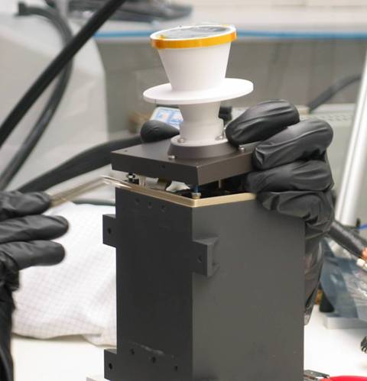
Venus Monitoring Camera
VMC was designed and manufactured by consortium of
MPS (Katlenburg-Lindau), IPF-DLR (Berlin) and IDA (Braunschweig)

Slide 3
Science goals → VMC channels
Dynamics Airglow Water Surface
VMC channel | Spectral range (½ max), nm | Maximum of sensitivity | FWHM
UV | 351 – 383 | 367 | 32
VIS | 502 – 568 | 520 | 66
NIR1 | 948 – 982 | 970 | 34
NIR2 | 988 – 1025 | 1000 | 37

Slide 4
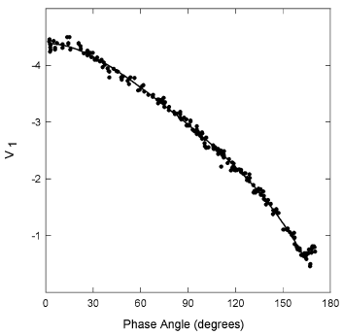
Why observations at small phase angles can be of special interest?
Venus phase function
Ground-based observations
(Mallama et al., 2006)
If the scattering particles are spherical and their size distribution is rather narrow,
they produce the interference features in the backscattering domain.
The angular positions of Max and Min are directly connected with the particle size relative to the wavelength,
and the influence of the refractive index is weak.
The particle sizes can be retrieved from the position of the interference features.

Slide 5
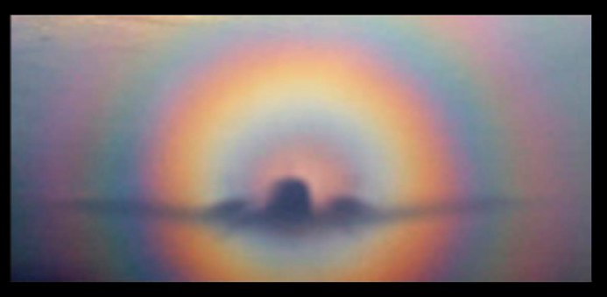
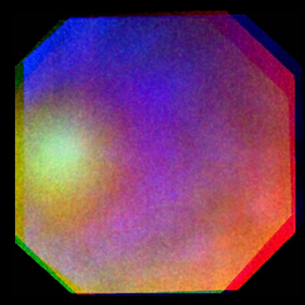
Glory
Earth
Venus

Slide 6
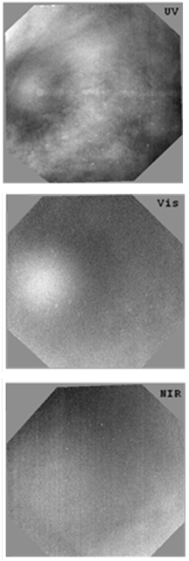
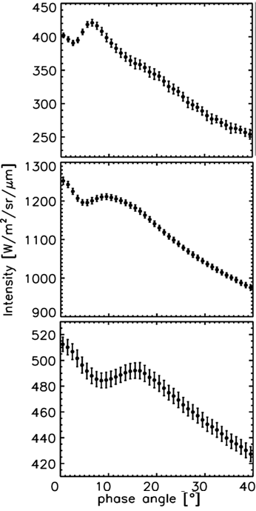
Glory observed
with VMC on
the Venus cloud tops
UV
(Local noon and nearly equator)
Vis
NIR
The phase curves are composed from the set of successive images.
14° in phase

Slide 7
The angular positions of Max and Min observed
in UV, Visible, and NIR correspond to mode-2 particles
The main contributor to
the light scattering
that occurs at the levels sounded by all VMC channels
are the mode-2 particles.
The refractive index values m_{r} (H₂SO₄) are taken from Palmer & Williams (1975)

Slide 8
However,
NIR
#1920
λ=0.965 μm
Measured : B(0°) > Bmax(17°)
Single-scat. model : F(0°) < Fmax(17°)

Slide 9
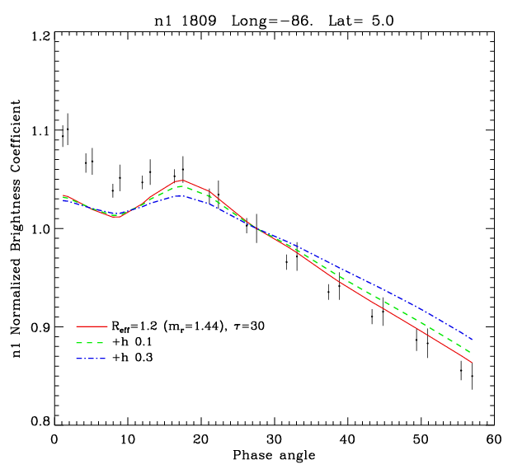
Measured and modeled NIR profiles
The profile is built from the set of successive images for the 1°х1° region
(orbit #1809).
The effect observed
in the single-scattering model qualitatively remains
after multiple scattering
in the clouds.
The slope ΔB/Δα after α ≈ 20° is steeper than that produced by mode-2 particles;
adding haze makes things worse.

Slide 10
What factors can produce B(0°) > Bmax(17°)
and steeper ΔB/Δα ?
(1) Particles of other sizes may be present in addition to mode 2
mode 1, R_{eff} = 0.23 μm → flattens the phase profile
mode 2’, R_{eff} = 1.6 μm → somewhat shifts Max and Min to 0° phase
(destroys glory)
mode 3, R_{eff} ≈> 2.7 μm
- if liquid (spherical)
if H₂SO₄ → makes additional features near 0° phase
if m_{r} is higher → B(0°) can be increased, but ΔB/Δα decreases
(destroys glory)
- if solid (crystals?) → The single scattering phase function of randomly oriented polydisperse crystals is flat at phase angles larger than 30 degree.
+
(2) The refractive index
of mode-2 particles is higher at the levels sounded by NIR →

Slide 11
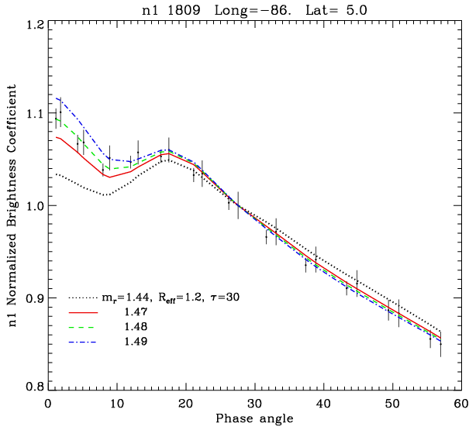
Mode-2 droplets with a higher refractive index
Single scattering
Measured and modeled phase profiles
NIR
The model with m_{r}=1.48 fits best the phase profile
measured in NIR #1809 at the specified region.

Slide 12
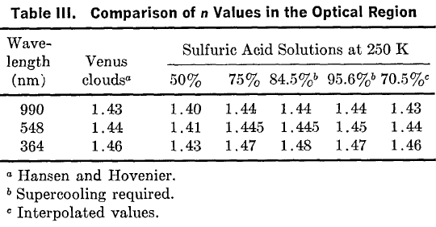
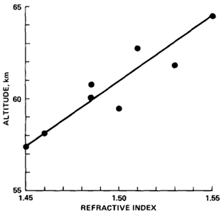
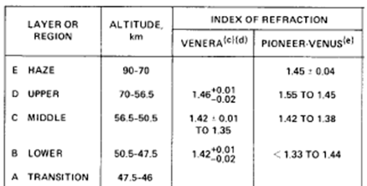
Comparison with the previous estimates of m_{r}
m_{r} > 1.44
H₂SO₄ (Palmer & Willams, 1975)
Obtained from
the experiments
on the PV-probes
(Toon et al., 1982)
(1974, ground-based polarimetry)
Venera- and PV-probes (Ragent et al., 1985)

Slide 13
What can increase the refractive index of mode-2 particles?
(1) Low temperatures? The refractive index of solutions increases with density,
and the density increases, when the temperature goes down.
But the effect is weak: Δ m_{r} ≈ 2% for ΔT=100°
(2) Admixture of some substance with a high refractive index?
H₂SO₄ may condense on solid mode-1 particles with high m_{r} .
Candidates (both absorb in UV) :
Ferric chloride FeCl₃ m > 1.6 ? soluble in H₂SO₄
Sulfur m =1.95
The phase function for the droplets with absorbing inclusions is roughly the same as that for the increased refractive index of the droplets.
+
However, the increased m_{r} is not observed by VMC everywhere.

Slide 14
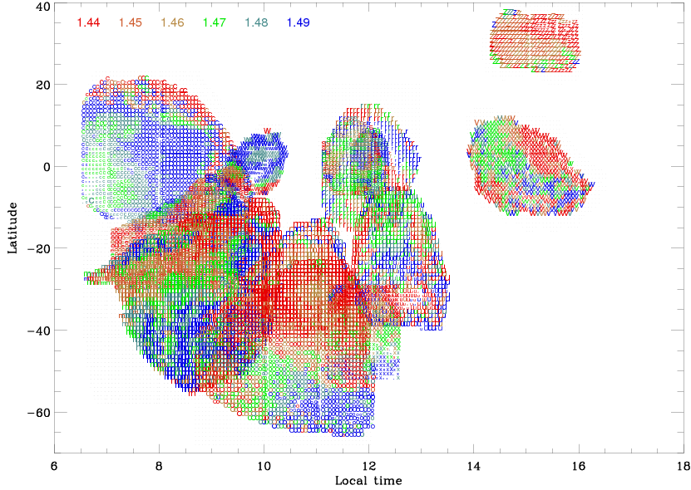
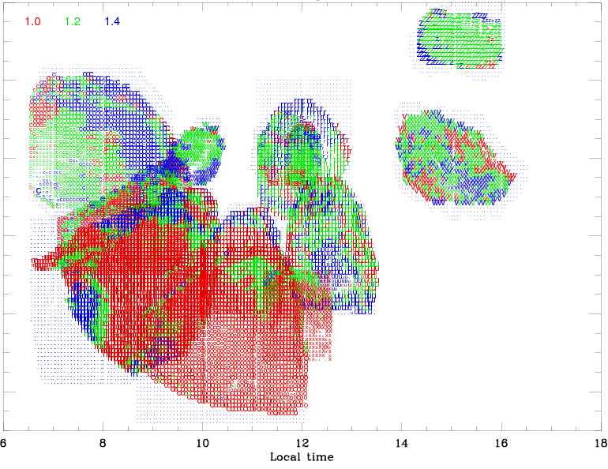
The fitting of the phase profiles measured in NIR (13 orbits)
with the models → the maps of m_{r} and R_{eff}
m_{r}= 1.44 … 1.49
R_{eff} = 1.0, 1.2, 1.4 μm
τ_{haze} = 0.0 … 0.7
Refractive index Effective radius
τ_{haze} = 0.0 – 0.2

Slide 15
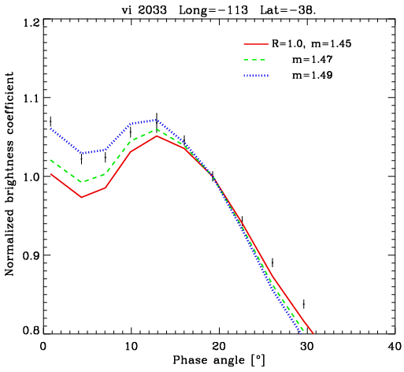
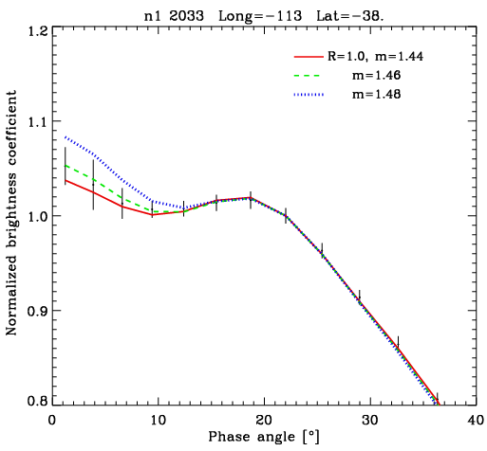
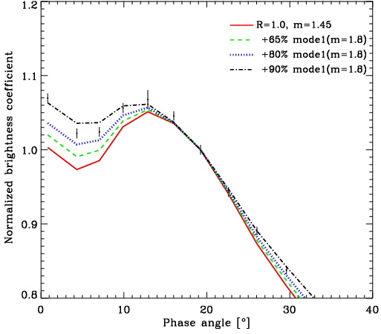
NIR versus Visible
Vis
NIR
mode -2
mode -2
mode -2
+ mode-1
The visible profiles cannot be fitted only by playing with m_{r} and R_{eff} of mode-2 particles.
The submicron mode-1 with high m_{r} is required.
Fitting the UV profiles is ambiguous:
too many parameters should be considered.

Slide 16
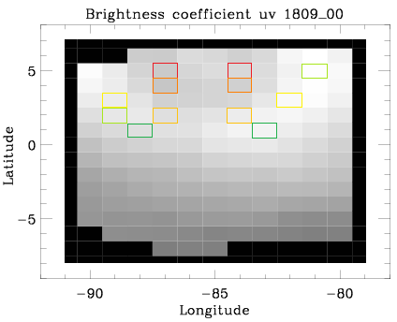
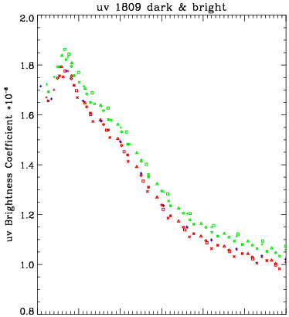
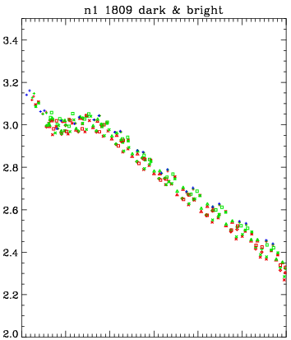
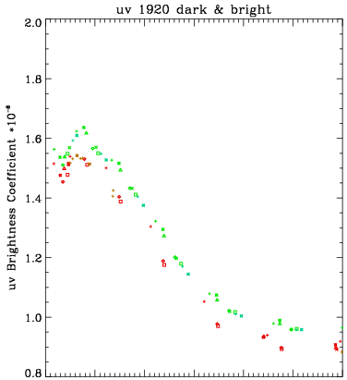
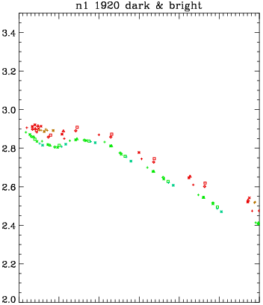
UV dark and bright regions
are compared
#1809
UV
NIR
The pairs observed at the same phase and zenith angles were selected.
No correlation
Possible causes (from modeling):
There are more mode-1 particles with high refractive index in the dark regions (ΔN ≈8-10%).
In the dark regions, mode-2 particles are somewhat larger (a small difference in the angular position of the glory max).
#1920
UV
NIR
Anti-correlation
Phase angle Phase angle

Slide 17
Conclusions
Presence of glory indicates spherical particles with a narrow size distribution in the upper clouds of Venus.
Angular positions of glory features correspond to mode-2 droplets in the upper clouds of Venus.
Bmax of the glory relative to B(α=0°) and the phase slope at α >20°suggest that in some cases mode-2 droplets have m_{r} > m_{r} (H₂SO₄).
This may be caused by a small admixture of FeCl₃ or amorphous sulfur (both can be contained in the clouds as mode-1 particles serving as condensation nuclei for H₂SO₄).
We cannot say however that there is only one type (in composition) of mode-1 and -2 particles.
No rule has been found to date in the time and spatial behavior of the variations of refractive index and size of cloud particles.
To fit the visible and UV phase profiles, one should assume that at least some particles of mode-1 in the clouds have a high refractive index.
Changes in their number can be one of the causes of UV contrasts (the case of no correlation with the NIR brightness).
The other cause can be a small change in the size of mode-2 particles (the case of anti-correlation with the NIR brightness).

Slide 18
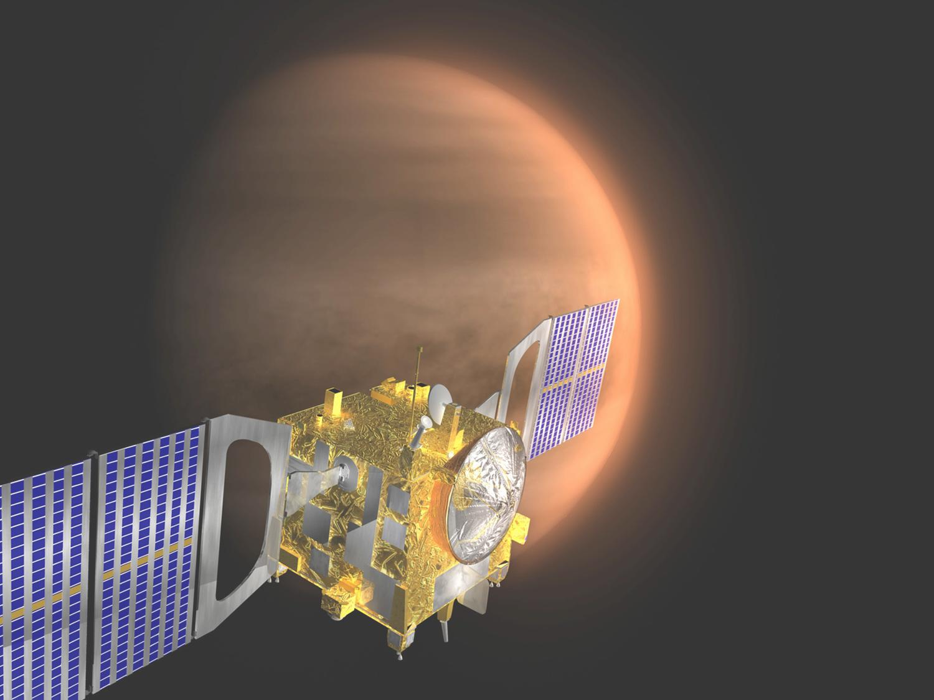
Thank you
for your
attention!

