Slide 1


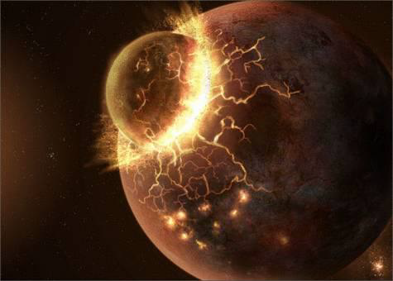
Thermal evolution of an early magma ocean in interaction with the atmosphere
T. Lebrun¹, H. Massol¹, E. Chassefière¹, A. Davaille², E. Marcq³, P. Sarda¹, F. Leblanc³, G. Brandeis⁴
¹ Univ Paris-Sud, Laboratoire IDES, UMR8148, Univ. Paris-Sud, CNRS, Bât. 504, Orsay, F-91405, France;
² FAST, Univ. Paris-Sud, CNRS, France
³ LATMOS, UVSQ, CNRS, Guyancourt, France
⁴ IPGP, Paris, France
The Third Moscow Solar System Symposium (3M-S³), Space Research Institute, Moscow, October 8-12, 2012

Slide 2
Goal of the study
Coupling of a thermal evolution model of a magma ocean with a 1-D radiative-convective atmosphere.
Exchange of volatiles between the solidifying magma ocean and the atmosphere through volatile (CO₂, H₂O) exsolution.
Radiative feedback of atmospheric CO₂ and H₂O through greenhouse effect on the surface temperature of the magma ocean.
➔Main goal : estimate the solidification time of the magma ocean from an initially molten stage, and the time required for a water ocean to form.

Slide 3
Model of magma ocean thermal evolution
Liquidus and solidus curves (from Abe, 1997) + adiabatic profiles
➔ the magma ocean solidifies from below.
Scheme of solidifying magma ocean (from Solomatov, 2007)
Melt fraction<0.4
- Thermal model based on the equation of energy balance.
- Radiative-convective atmospheric model from Marcq (2012) : H₂O-H₂O, CO₂-CO₂ opacities from a k-correlated code + water clouds in the most zone.
- Balancing of convective heat flux from the mantle at the surface and the upward radiative atmospheric heat flux at the surface.

Slide 4
Comparison without atmosphere/ with radiative-convective model
Primitive Earth: 300 bar H₂O, 100 bar CO₂, 5 bar N₂
- End of magma ocean phase when solid volume fraction reaches 98%.
- Primitive plate appearance time when the rheology front reaches the surface.
- Condensation of water (when occurs) at primitive plate appearance.

Slide 5
Sensitivity to volatile amounts
- 300 bar H₂O : 1 terrestrial ocean
- 100 bar CO₂ : present content of Venus atmosphere and terrestrial carbonates
100 bar
300 bar
1000 bar
H₂O
Time for water ocean condensation
Duration of magma ocean
CO₂

Slide 6
Sensitivity to the initial magma ocean depth and extinct radioactivity
- 300 bar H₂O
- 100 bar CO₂
- Weak effect of radiogenic heat production of U, Th, K
- Strong effect of ²⁶Al radioactivity, but only for very early accretion times

Slide 7
Sensitivity to solar flux
Earth placed at different distances from the Sun : for distance smaller than 0.66 AU, no condensation of water vapor (virtually infinite duration of the magma ocean)
Time required to form a water ocean
Magma ocean duration

Slide 8
Compared cases of Mars, Earth, Venus
Venus
Venus
Time required to form a water ocean :
- ≈0.1 Myr on Mars
- ≈1 Myr on Earth
- ≈10 Myr on Venus
Earth
Earth
Water condensation sequence
Mars
Mars

Slide 9
Main conclusions and questions
Rapid condensation of an ocean of water after main accretion sequence : <1 Myr for Earth and Mars, ≈10 Myr for Venus.
Venus close to the distance (0.66 AU) below which an Earth-size planet remains in the magma ocean size. Did a water ocean form on Venus?
Time required to condense a water ocean : < average time between major impacts for Mars and the Earth (resp. 0.1 and 1 Myr) : a water ocean may form between major impacts (probably not for Venus). Could it explain more atmospheric loss on Mars and the Earth? (see Genda et al., Nature, 2006)
The present model doesn’t take into account energy input through impacts of small embryos, nor hydrodynamic escape. Further calculations including these effects required.

