Slide 1
Evolution of understanding of solar wind-gaseous obstacle interaction
O. Vaisberg
Space Research Institute (IKI), Moscow, Russia
Talk outlay
• Space missions to Mars and Venus
• Initial concepts
• Main regions of interaction region/induced magnetosphere
• Solar wind induced mass loss
• Open issues
The third Moscow International Solar System Symposium (3M-S3)
October 8 - 12, 2012, Moscow, Russia

Slide 2
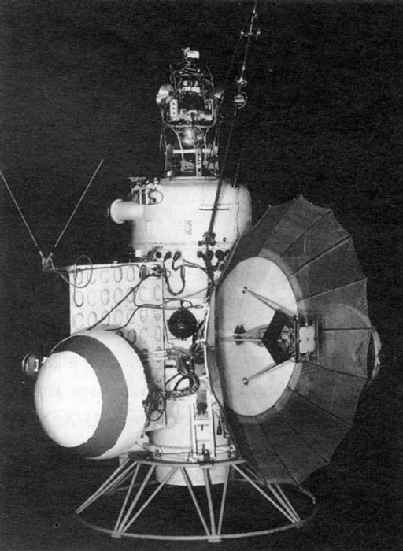
First Mars probe Mars-1
Launched 1 ноября 1962, mass 893,5 кг, the intent of flying by the planet at a distance of about 11,000 km.
It was designed to image the surface and to measure cosmic radiation, micrometeoroid impacts and Mars' magnetic field, radiation environment, atmospheric structure, and possible organic compounds.
The probe recorded Taurids meteor shower. Interplanetary magnetic of 3-9 gammas were measured, and the solar wind was detected. Cosmic rays measurements showed that their intensity had almost doubled since 1959. The Earth radiation belts were measured.
On 21 March 1963 at a distance of 106.76 0,000 km from Earth communications ceased.
Mars 1 closest approach to Mars occurred on 19 June 1963 at a distance of approximately 193,000 km, after which the spacecraft entered a heliocentric orbit.
The third Moscow International Solar System Symposium (3M-S3)
October 8 - 12, 2012, Moscow, Russia
2

Slide 3
Solar-Wind Interaction with the Planets Mercury, Venus, and Mars, Moscow, November 17-21, 1975
From left to write. Sitting: John Spreiter, Oleg Vaisberg, Alex Dessler, Herbert Bridge, Mai Izakov, Tamara Breus, Igor Podgorny, Oleg Belotserkovski, Velior Shabansky, Norman Ness, N.Zhigulev, Shmaiye Dolginov, Alexander Lipatov, Konstantin Gingauz, Siegfried Bauer; standing: Alex Galeev, N.Savich, Lev Zhuzgov, Stanislav Romanov, Eugene Yeroshenko, Georgy Zastenker, Lev Zeleny, Eduard Dubinin, Anatoly Bogdanov, Valery Smirnov, V.Mitnitski, and Paul Cloutier.
The third Moscow International Solar System Symposium (3M-S3)
October 8 - 12, 2012, Moscow, Russia
3

Slide 4
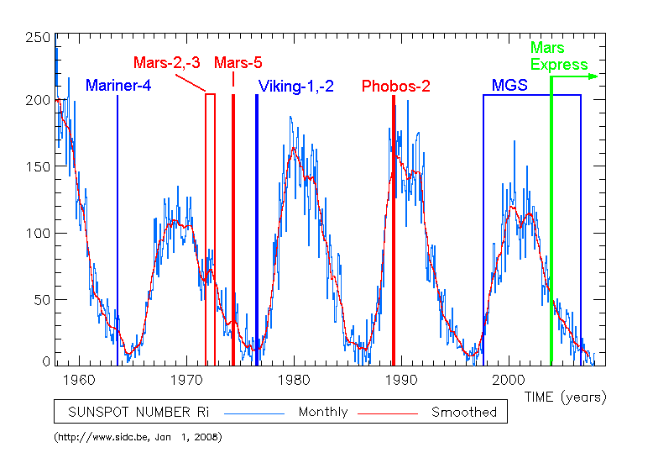
Mars probes in solar activity cycles
Mars-1 launch
The third Moscow International Solar System Symposium (3M-S3)
October 8 - 12, 2012, Moscow, Russia
4

Slide 5
Venus probes in solar activity cycles
The third Moscow International Solar System Symposium (3M-S3)
October 8 - 12, 2012, Moscow, Russia

Slide 6
Early concepts
First theoretical model of the solar wind interaction with gaseous obstacle was proposed by Alfven [1957] in terms of field line draping due to loading by pick-up ions produced in close vicinity of a comet.
In electromagnetic model of interaction of Dessler [1968] the solar wind motional electric field induces currents within the ionosphere of non-magnetized planets. Induced magnetic field deflects the solar wind and leads to formation of a shock in the supersonic flow. The solar wind pressure balanced by the induced magnetic field pressure is applied to the ionosphere and, in turn, is balanced by viscous stress of the neutral atmosphere.
Cloutier et al., [1969] assumed that the solar wind directly enters the atmosphere.
The third Moscow International Solar System Symposium (3M-S3)
October 8 - 12, 2012, Moscow, Russia

Slide 7
Structure of interaction region
Boundaries and regions in near-Venus space as measured with earlier spacecraft
Ion flow characteristics along Venera-10 orbit [Vaisberg et al., 1976]
The third Moscow International Solar System Symposium (3M-S3)
October 8 - 12, 2012, Moscow, Russia

Slide 8
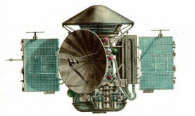
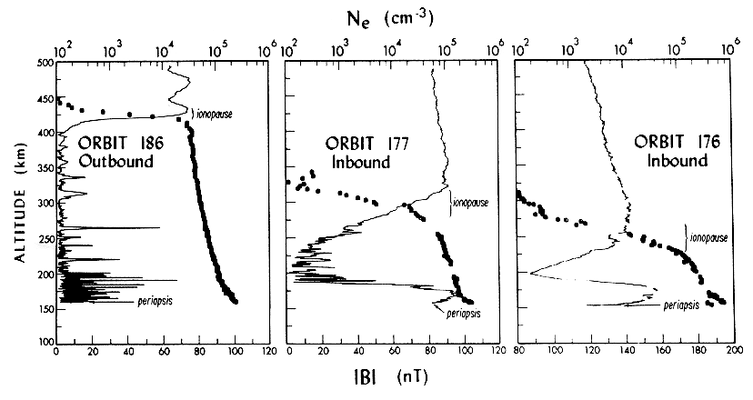
Obstacle on the dayside
Computer simulation of solar wind interaction with Venus [Lipatov, 1978] : magnetic barrier forms on the dayside
Dayside obstacle crossing at Mars by Mars-2: comparison of magnetic field pressure with plasma pressure. Arrow indicates where plasma adds to total plasma balance in obstacle. Magnetic field data courtesy Sh.Dolginov, ion data O.Vaisberg, electron data courtesy K.Gringauz.
Magnetic field strength and electron density for the three PVO passes [Russell and Vaisberg, 1983]. Changes of magnetic barrier and ionosphere with increasing solar wind pressure.
The third Moscow International Solar System Symposium (3M-S3)
October 8 - 12, 2012, Moscow, Russia
8

Slide 9
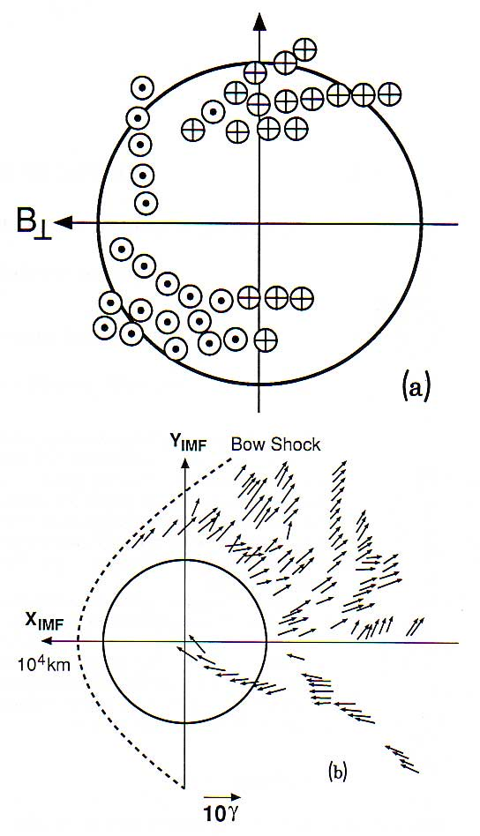
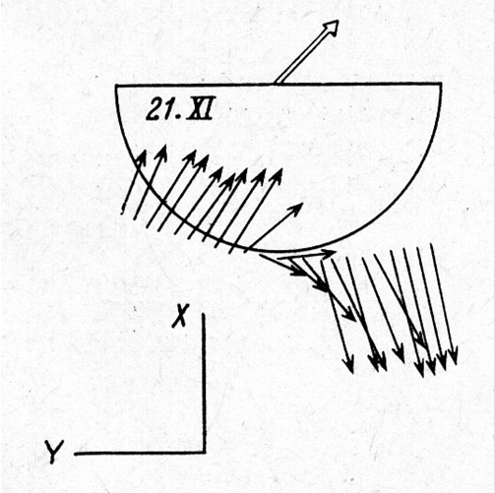
Induced magnetic tail
Magnetic field orientation in the tail: (a) Вх component of Venusian tail magnetic field in coordinate system V-B (solar wind velocity V directed out of viewing plane, IMF transverse component is along Y axis) [Yerospehnko, 1979]. (b) magnetic field vectors in plane (V, VxB) [Dolginov et al., 1981]
Classic induced tail: Venera-10 pass on 11.21.1985 shows two lobes and central plasma sheet.
The third Moscow International Solar System Symposium (3M-S3)
October 8 - 12, 2012, Moscow, Russia

Slide 10
Planetary ions in ionosheath and tail
Solar wind (L) and planetary ions (H) in magnetosheath and in tail [Vaisberg, 1976]. Note the termination of light ions with transition to planetary ions flow at magnetic tail boundary.
Ion composition in the tail and external flow as measured on Phobos-2/ASPERA [Lundin et al., 1990] .
The third Moscow International Solar System Symposium (3M-S3)
October 8 - 12, 2012, Moscow, Russia
10

Slide 11
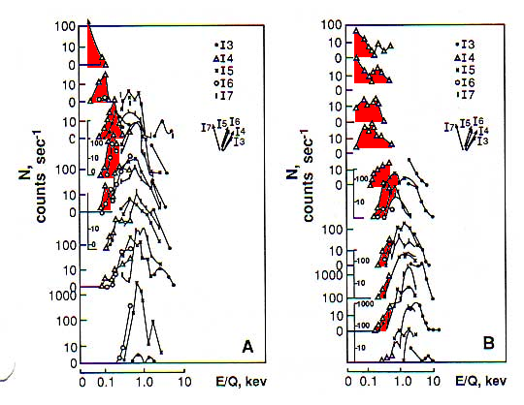
Plasma in induced tail
Asymmetry of planetary ion flow in the tail: view from the tail with Y axis parallel to transverse component of IMF
Two crossings of Mars interaction region:
A – low magnetic latitude, B – high magnetic latitude [Vaisberg et al., 1974]
The third Moscow International Solar System Symposium (3M-S3)
October 8 - 12, 2012, Moscow, Russia

Slide 12
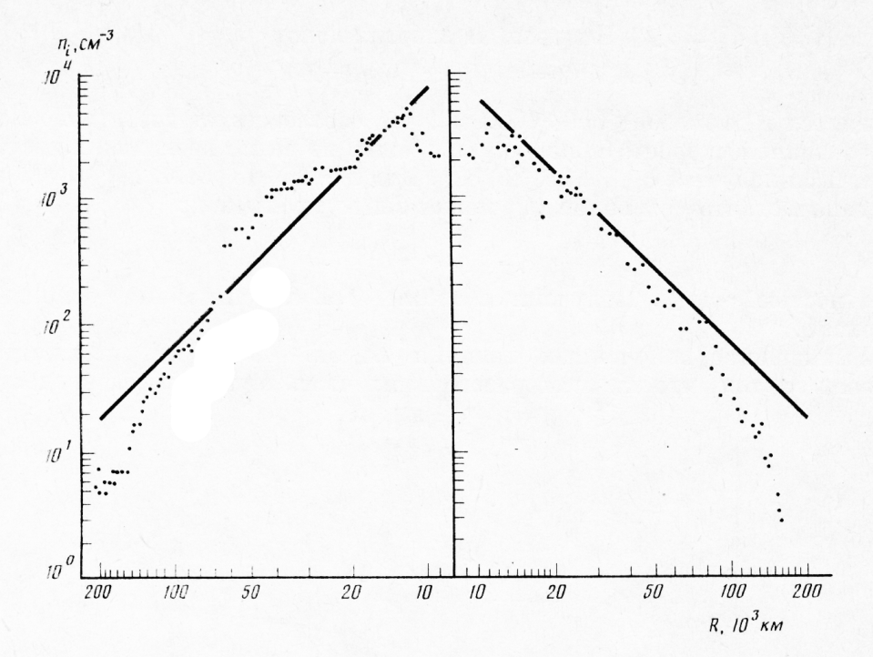
Sharp induced tail boundary
Profile of cometary ions in Halley’s comet along VEGA trajectory. Sharp drop of number density at outer boundaries [Vaisberg et al., 1986].
Sharp transition from planetary ion flow in the tail to external solar wind flow at tail boundary [Romanov et al., 1978]

Slide 13
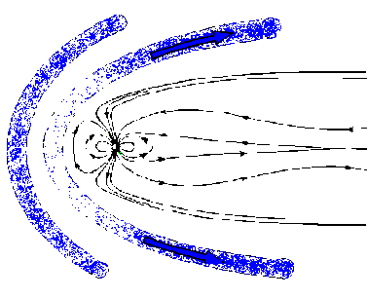
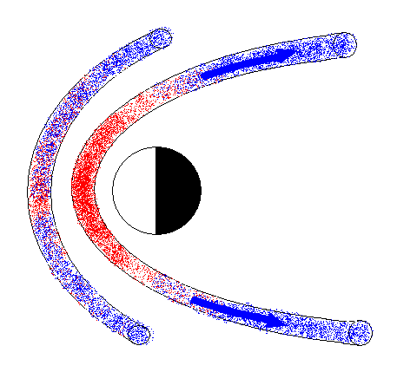
Formation of induced magnetosphere
Plasma depletion of decelerated and draped flux tubes in front of an obstacle [Zwan and Wolfe, 1976] (left) and mass-loading by planetary ions (right).
Asymmetric mass loading at gaseous obstacle leads to replacement of protons, escaping along draped flux tubes, with photoions. Location of this boundary between two plasma populations is determined by equipartition of time the external flow pass the obstacle and of mass-loading time. [Zeleny and Vaisberg, 1985].
Comparison of tail boundary locations of Mars, Venus, and comets with model.
The third Moscow International Solar System Symposium (3M-S3)
October 8 - 12, 2012, Moscow, Russia
13

Slide 14
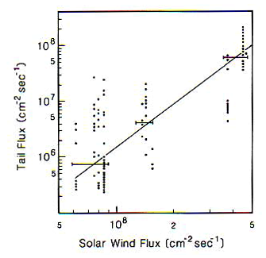
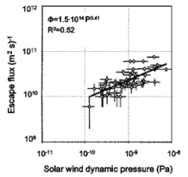
Martian tail flow - mass loss
Martian tail flow - mass loss
Ion flux density in the Martian tail plotted against solar wind number flux [Vaisberg et al., 1976]
Average ion escape flux in the Martian tail plotted against solar wind dynamic pressure [Lundin et al. 2008]
 | Vaisberg et al., 1976. Mars-5 | Verigin et al., 1991 Phobos-2/TAUS | Lundin et al., 1989 Phobos-2/Aspera | Barabash et al., ME/Aspera-3
Measured flux in the tail | average 3 x 10⁶ ions cm⁻² s⁻¹ | 2.5 x 10⁷ ions cm⁻² s⁻¹ | 3 x 10⁶ ions cm⁻² s⁻¹ | < 1 x 10⁶ ions cm⁻² s⁻¹
Calculated mass loss | 1 x 10 ²⁵ s^{–1} ~ 250 g s^{–1} | 5 x 10 ²⁴ s^{–1} 150 g s^{–1} | 2 x 10 ²⁵ s^{–1} 500 g s^{–1} | 3.9 x 10 ²³ s^{–1} 18 g s^{–1}
The third Moscow International Solar System Symposium (3M-S3)
October 8 - 12, 2012, Moscow, Russia
14

Slide 15
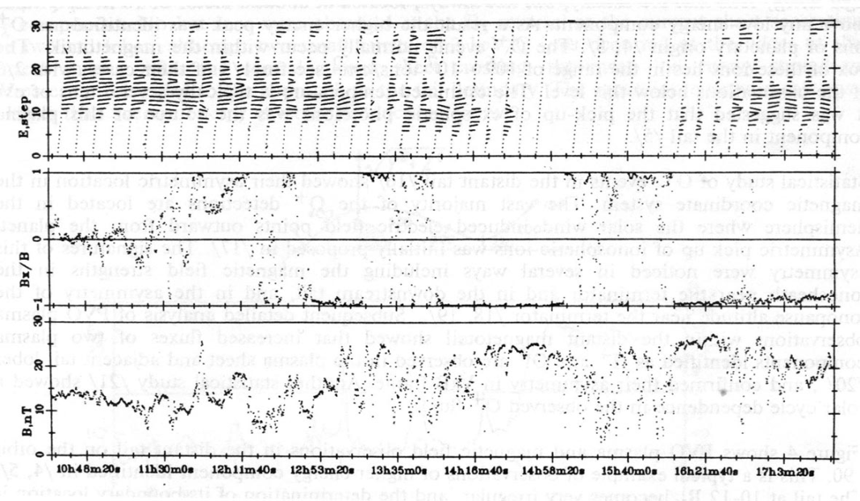
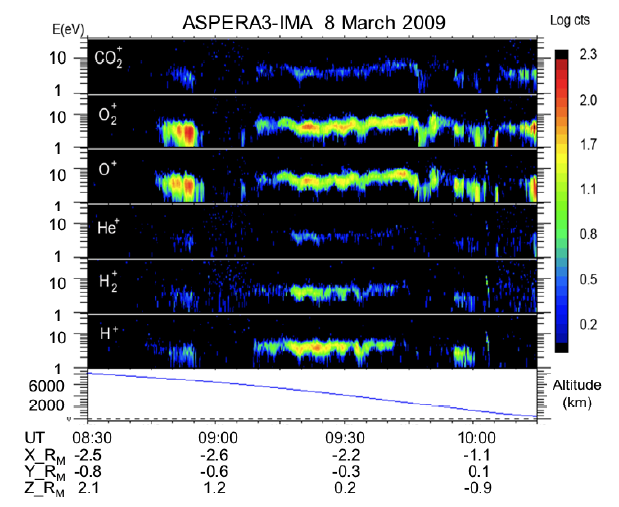
Other escape components
Accelerated ions in current sheets: energy-time spectrogram and the magnetic field in the distant Venus tail on the PVO orbit 0190, June 13, 1979.
Energy-time spectrogram of low energy (<50 eV) ionospheric ion outflow from Mars as measured on MEX [Lundin, 2004].
The third Moscow International Solar System Symposium (3M-S3)
October 8 - 12, 2012, Moscow, Russia

Slide 16
Conclusions and open issues
Asymmetric mass loading and mass depletion of solar wind magnetic flux tubes explain main features of induced (accretion) magnetosphere.
Following solar wind induced mass loss components are identified:
mass-loading in ionosheath and magnetic barrier
acceleration in the current sheets
ionospheric escape
Open issues
- Total solar wind induced escape rate is poorly known
- Relative role of different escape components (mass loading, current sheets acceleration, ionospheric outflow/plasma clouds) is unknown
- Plasma properties in the tail current sheet
- The role of (strong) solar wind transients
- The origin of thin tail boundary
The third Moscow International Solar System Symposium (3M-S3)
October 8 - 12, 2012, Moscow, Russia

