Slide 1
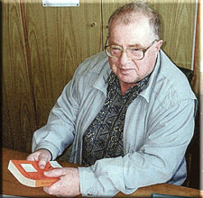
Monitoring of Solar system planets and detection of exoplanets by space telescopes Planetary Monitoring and Stellar Patrol
A. Tavrov, A. Kiselev, I. Vinogrdov, V. Ananjeva ,
V. Gnedykh, N. Sanko, L. Ksanfomaliti, O. Koravlev
Space Research Institute of RAS
Moroz V. I. 1931—2004

Slide 2
Outline
Planetary monitoring – the pilot project of 0.6 m. telescope on RS ISS
Stellar Patrol – extended project of 1.5 m. telescope an orbital observatory
Missions’ aims:
  Monitoring of Solar System planets
  Engineering run to image exoplanets
Telescope instruments
Project phase …when to launch …etc.

Slide 3
Planetary monitoring telescope: mission aims
The planetology studies the internal structure, the surface and the atmosphere of planets. Theoretical models and experimental methods combine the orbital telescope observations with planetary landing missions. The both results add and re-check each other. Mostly accessible for orbital observation are the Earth group planets, gas giants and their satellites.
Mars
Water vapor & isotopic ratio of HDO/H2O
Methane (CH4)
Ozone (O3)
Dust storm & clouds
Venus
Sulfur-contained components
UV absorber
Night glow
Atmosphere dynamics
Asteroid hazards
Space debris
Monitoring of orbital events…etc.
Giant planets
Lunar exosphere
Engineering run for exoplanets imaging
Meteor showers
Icy satellites of planets
Composition of comets

Slide 4
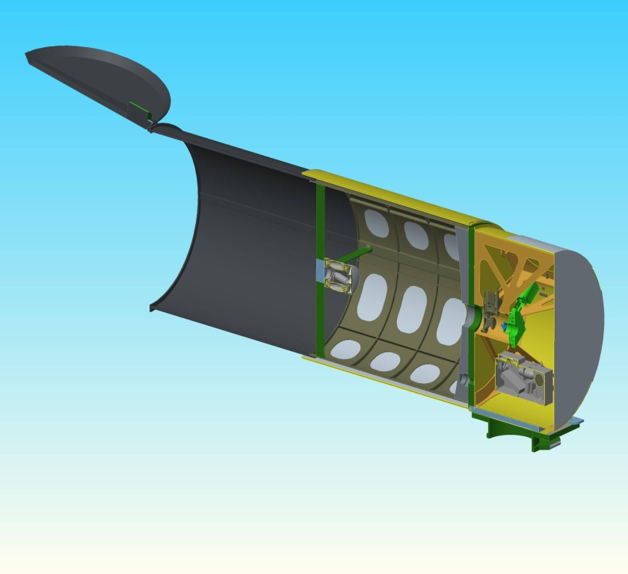
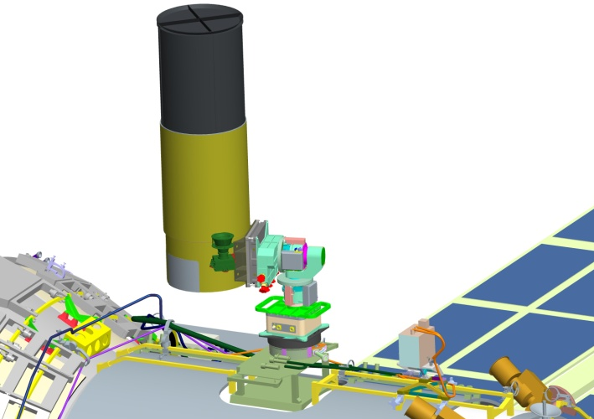
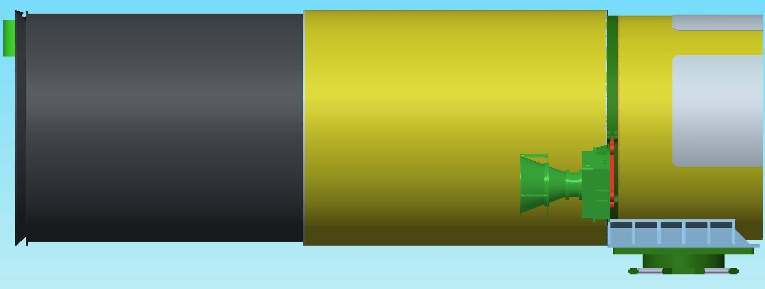
Planetary monitoring –telescope on the Russian Segment of ISS
We aim to equip the RS ISS with a telescope (of a Ø 600 mm primary mirror: angular resolution - 0.2 arc second), a two-axis guiding platform and science instruments:
CCD photometer, stellar coronagraph, spectrometers and a spectro-polarimeter in UV, visible and NIR wavelength range.
Telescope Т600 projected view
Telescope placement on
two -axis rotating platform

Slide 5
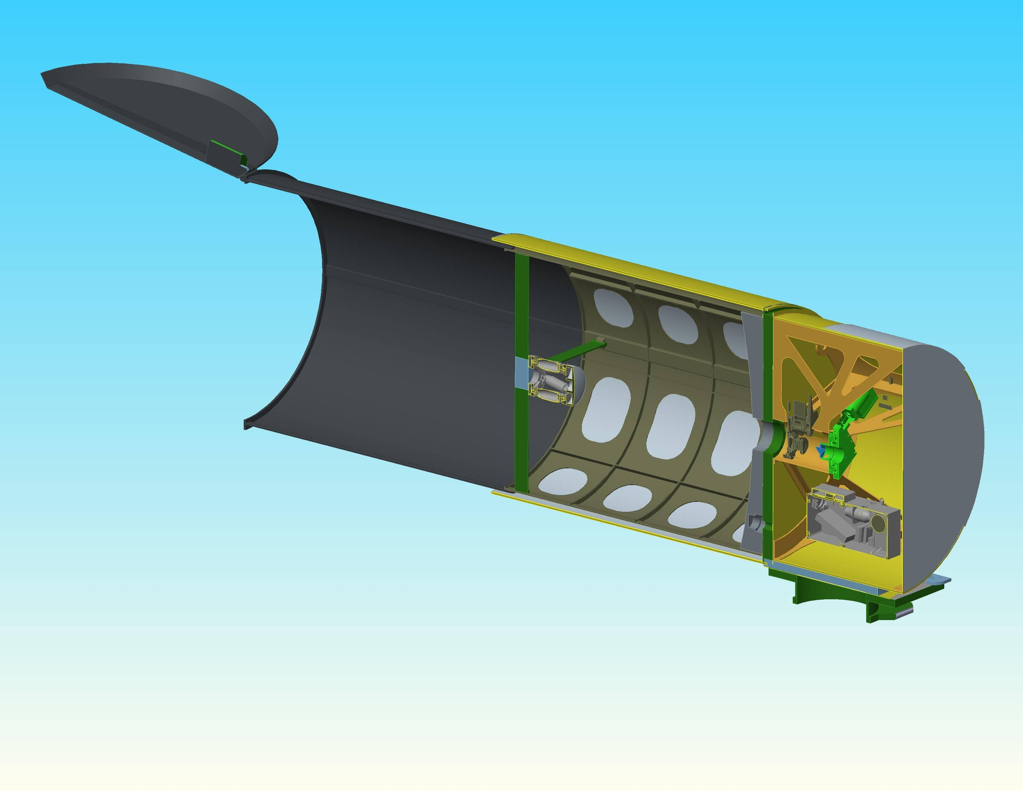

Planetary monitoring telescope construction details: mass 100 kg,
outer diameter 650 mm,
length 2200/1200 mm
Science instruments
container
Pointing error compensation by a low mass secondary mirror tilt on hexapod driver
Platform pointing error ~ 10 arc. min

Slide 6
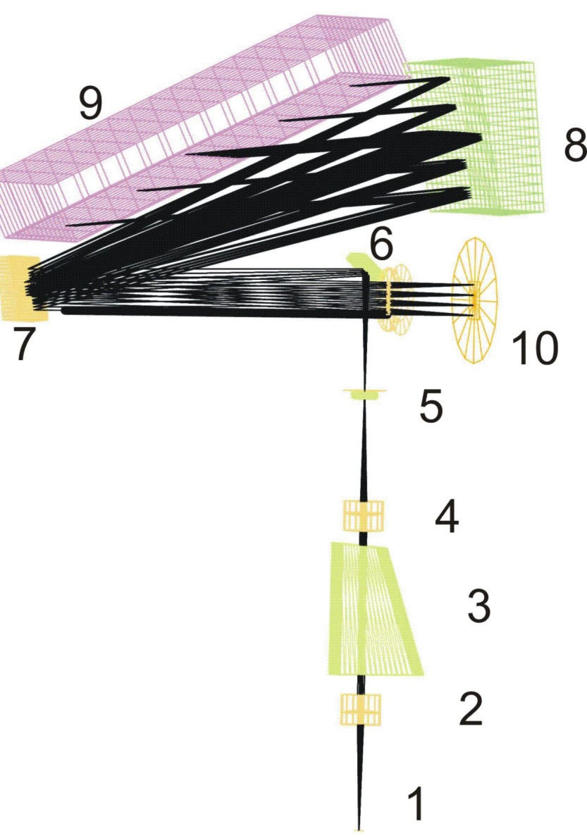
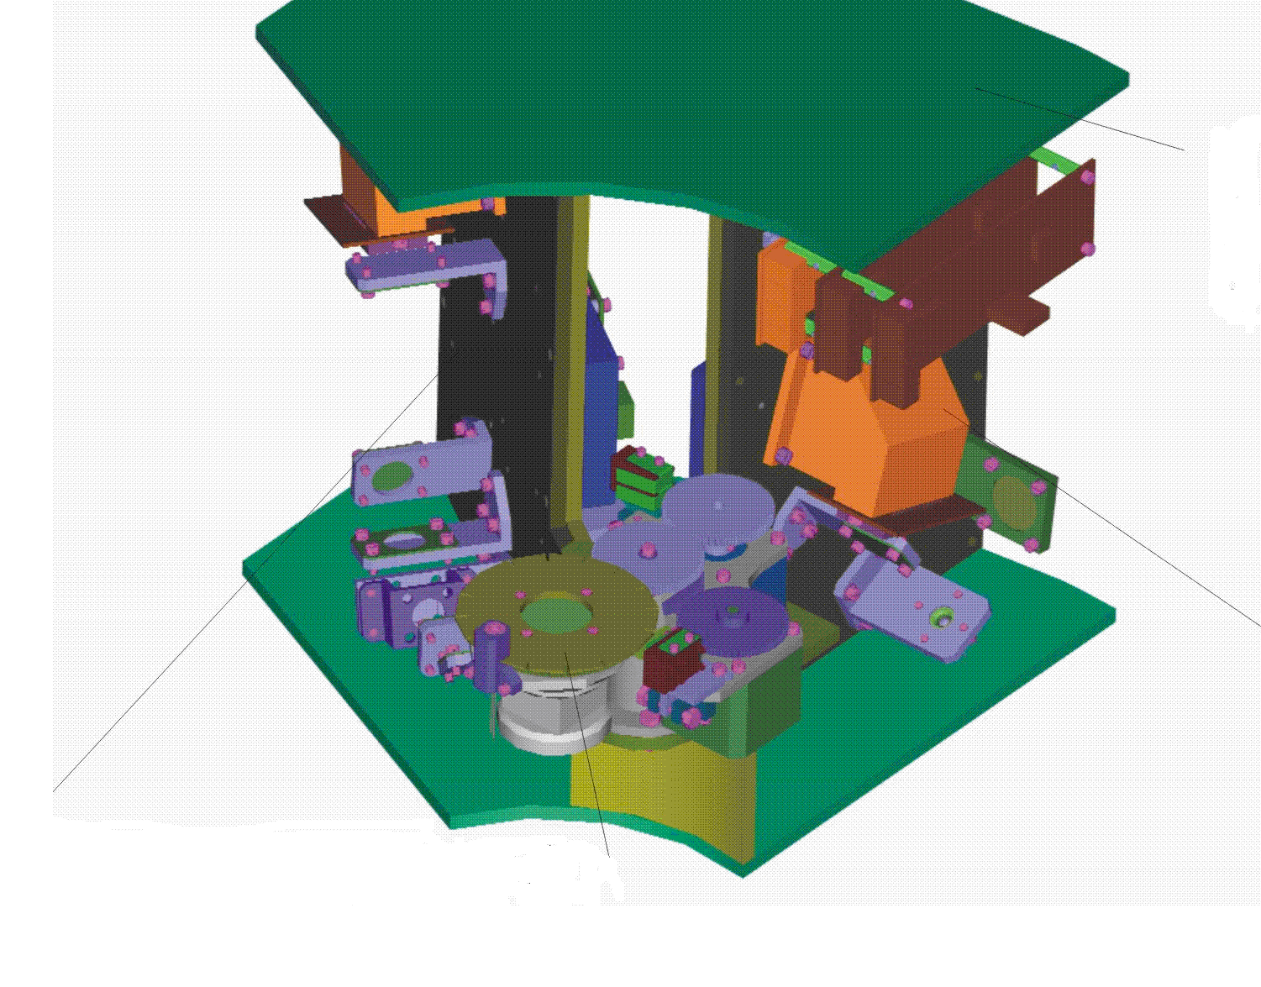
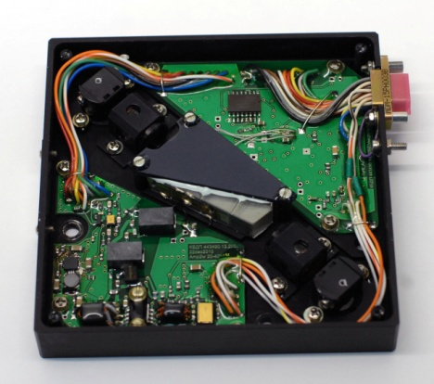
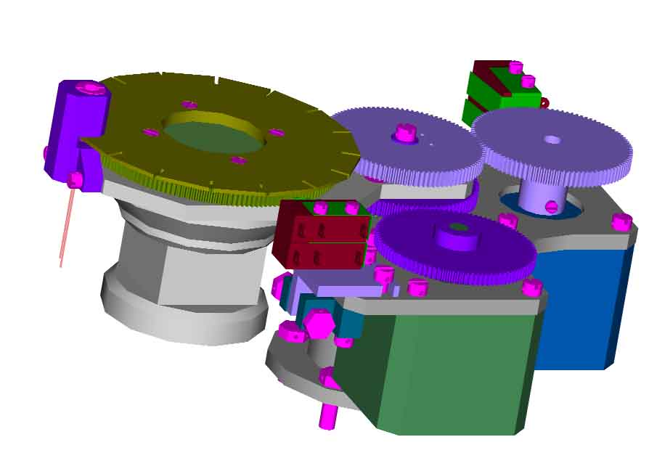
Planetary monitoring telescope equipped by 5 instruments
1. High resolution IR spectro-meter R>10000, λ=1..4 μm
2, 3. (FTS) Static Fourier Transform Spectrometer & Spectropolarimeter unit
λ= 0,23..0,4 μm
4. Photometer with filters wheel (U, V, B, G, R, I):
imaging CCD 1530х1020 pixel,
guiding functions.
TIMM Phobos-Grunt
prototype
Co-operation with Ukraine

Slide 7
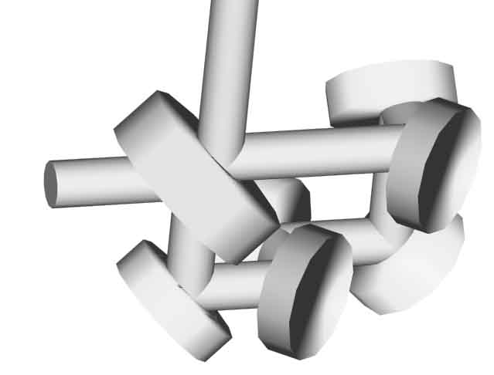
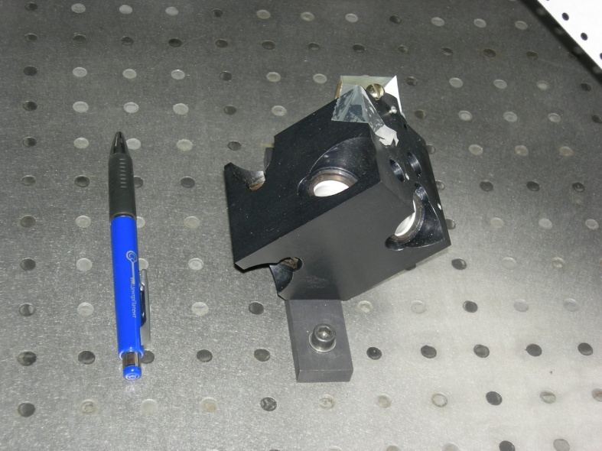
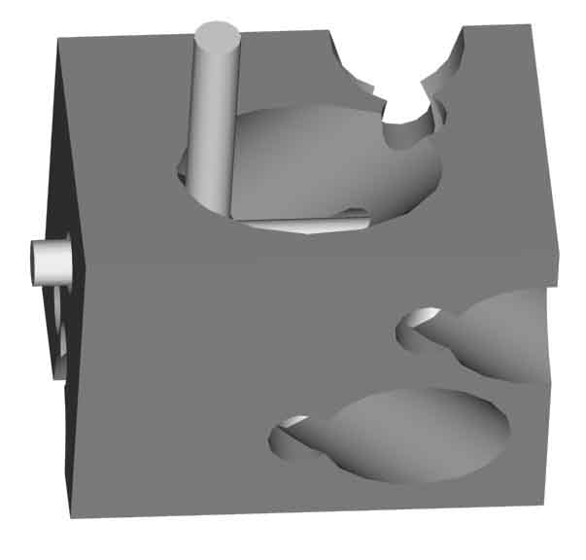
5. Stellar achromatic coronagraph: λ=0.6..3 μm
Schematics
Светлый выход
Темный выход
Low resolution NIR spectrometer
Планета
Звезда и планета
CAD & lab. experiment

Slide 8
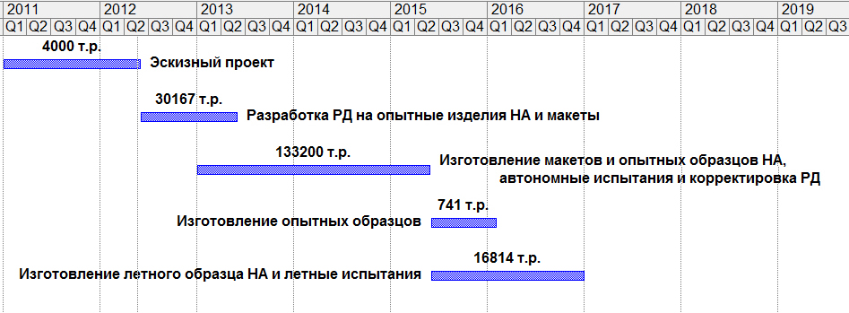
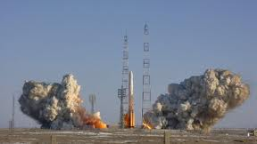
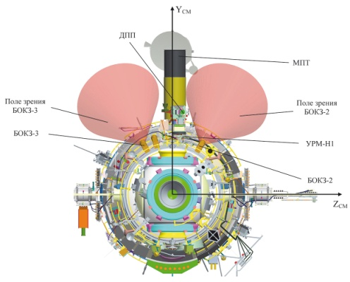
Planetary monitoring telescope project phase

Slide 9
Stellar Patrol – 1.5 m.
orbital observatory telescope: mission aims
Exoplanets imaging by nearest stars within a 5..10 pc. radius,
Low spectral resolution analysis of exoplanets (color analysis)
Exoplanet transit by the known RV-candidates
Solar system planetary monitoring
Astrophysical targets
Venus
Sulfur-contained components
UV absorber
Night glow
Atmosphere dynamics
Asteroid hazards
Space debris
Monitoring of orbital events…etc.
Mars
Water vapor & isotopic ratio of HDO/H2O
Methane (CH4)
Ozone (O3)
Dust storm & clouds
Icy satellites of planets
Composition of comets
Giant planets
Lunar exosphere
Meteor showers

Slide 10
Stellar Patrol – a 1.5 m.
orbital observatory: telescope parameters
mass 500 kg
1.5 meter primary mirror diameter telescope
axial Ritchie Ch instruments planetary ~ 1 arc. min rétien optical scheme or other
wavelengths range: λ=0.25..3 µm
field of view:
      telescope ~ 2 arc. min
      instruments planetary ~ 1 arc. min
      instruments exoplanetary ~ 1 arc. sec
telescope length ~ 5 m
Orbit under study
lifetime 5…7 years
mass 500 kg
1.5 meter primary mirror diameter telescope
axial Ritchie Ch instruments planetary ~ 1 arc. min rétien optical scheme or other
wavelengths range: λ=0.25..3 µm
field of view:
      telescope ~ 2 arc. min
      instruments planetary ~ 1 arc. min
      instruments exoplanetary ~ 1 arc. sec
telescope length ~ 5 m
Orbit under study
lifetime 5…7 years

Slide 11
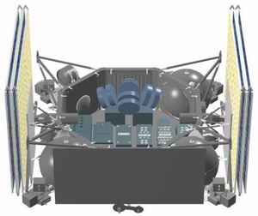
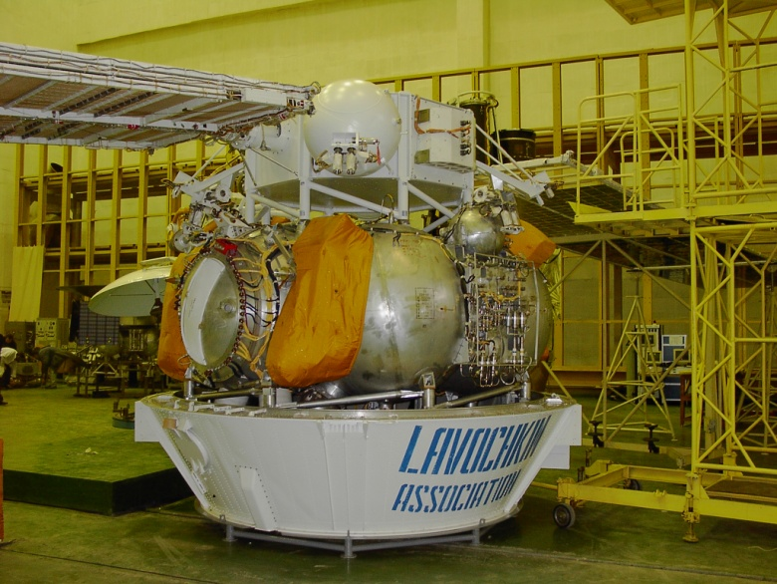
Stellar Patrol
orbital observatory: platform parameters
NAVIGTOR platform Ok
http://www.oact.inaf.it/wso/
wic-jun06/28_06/NV-platform-rus.ppt#3
sci. instrumental mass up to 2500 kg
pointing error ± 2 arc. min (row) /
  ± 2.5 arc. sec under stabilization
electric power 1500 kWt

Slide 12

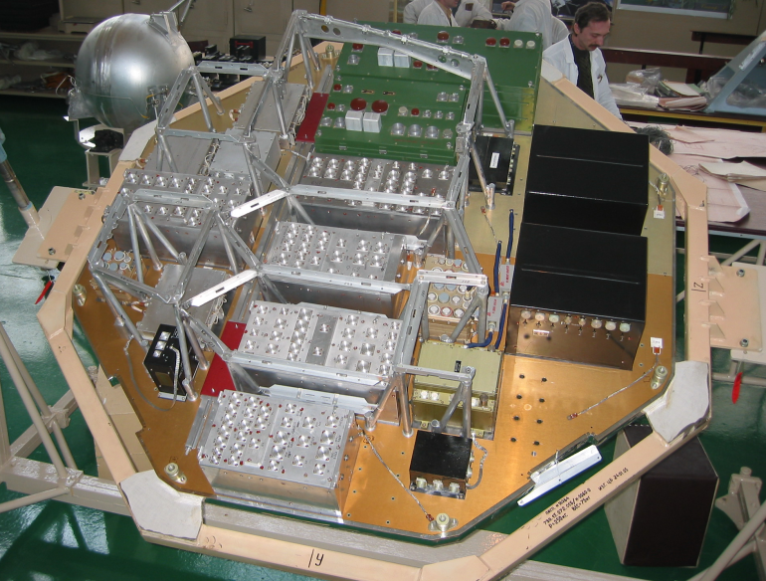
Stellar Patrol – orbital observatory telescope: project phase
Construction 2016-2024
Launch 2025

Slide 13
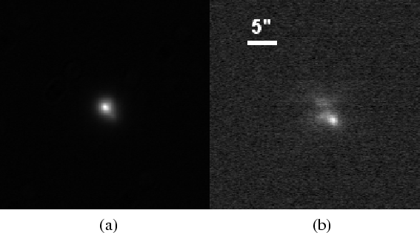
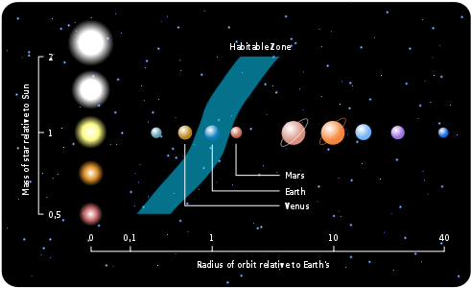
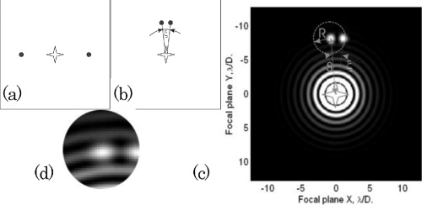

Orbital telescope with stellar coronagraph
Exoplanets imaging by nearest stars within a 5..10 pc. radius,
Low spectral resolution analysis of exoplanets (color analysis)
Exoplanet transit by the known RV-candidates
Solar system planetary monitoring
Astrophysical targets
Habitable zone
The companion appears clearly
in the coronagraphic image

Slide 14
Conclusions
Planetary monitoring – the pilot project of 0.6 m. telescope on RS ISS
Stellar Patrol – extended project of 1.5 m. telescope an orbital observatory
We are at the very begin phase
Both projects are open for discussion to consider your science program

Slide 15
Thank you!

