Slide 1
Photometric analysis of Martian moon Phobos with the HRSC on Mars Express
Presentation at the Moscow Solar System Symposium 2012:
A. Pasewaldt¹, K. Willner², J. Oberst^{1,2}, Frank Scholten¹, M. Wählisch¹, K.-D. Matz¹, T. Roatsch¹, H. Hoffmann¹, A. Grechishev³ and V. Patsyn³
¹ DLR Berlin, Institute of Planetary Research, Berlin
² TU Berlin, Institute for Geodesy and Geoinformation Science, Berlin ³ MIIGAiK, MIIGAiK Extraterrestrial Laboratory, Moscow

Slide 2
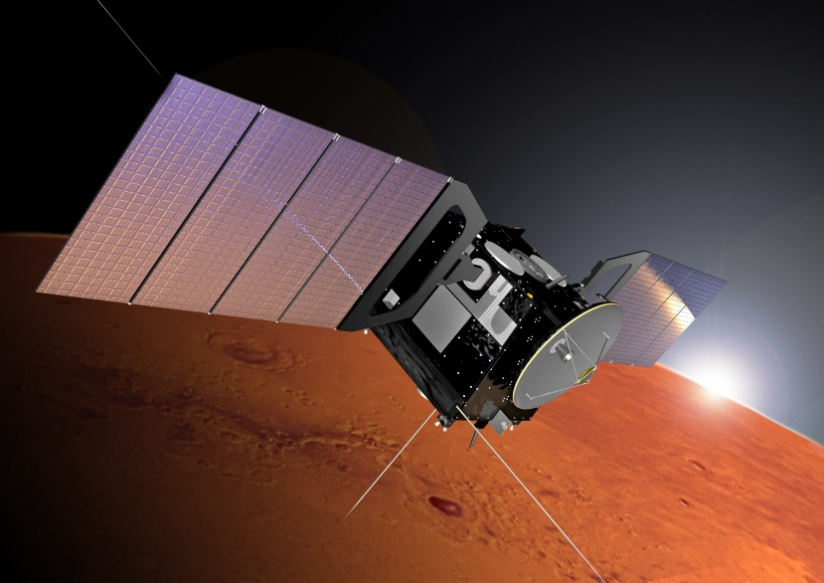
Mars Express (MEX)
ESA‘s 1st mission to another planet
Orbit insertion: End of 2003
Mission goals:
Mars cartography
Investigation of Martian atmosphere and surface
Phobos flybys
7 scientific instruments, underneath the HRSC camera
© ESA

Slide 3
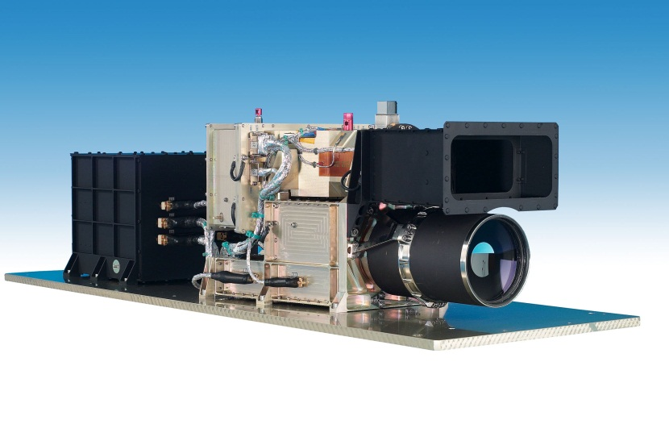
High Resolution Stereo Camera (HRSC)
Multi-line pushbroom scanner
9 CCD lines in a focal plane
5 panchromatic channels
4 color channels
Image size: 5,184 pixels/line
f = 175 mm
f-ratio = 5.6
IFOV = 8.2 arcsec
Geometric resolution: 10 m/px at an altitude of 250 km
Radiometric resolution: 8 bit
© DLR

Slide 4
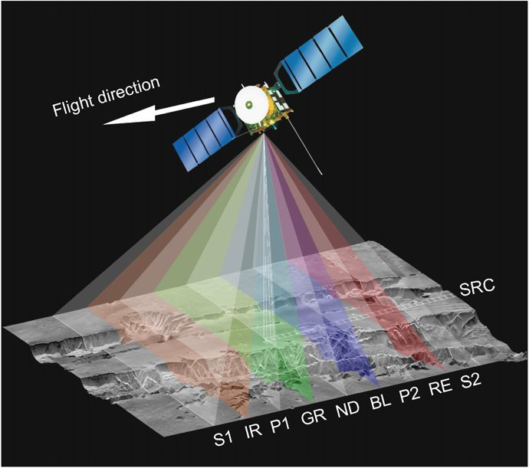
Panchromatic channels
Channel | Bandcenter/-width | Viewing angle
S2 | 675 ± 90 * | +18.9°
P2 |  | +12.9°
ND |  | 0°
P1 |  | -12.9°
S1 |  | -18.9°
© DLR
* Includes orange and red spectral regions and parts of near-infrared;
© DLR

Slide 5
HRSC coverage map of Phobos
About 170 Phobos flybys with flyby distances between 93 and 5,534 km
About 60 Phobos flybys where five panchromatic channels were active (Pixel binning: 2, 4, 8)
About 18 Phobos flybys with a good spatial resolution (4-90 m/px)

Slide 6
Bundle adjustment (Willner 2010)
Bundle adjustment (DLR hwbundle)
Input: Tie points, control points, exterior orientation
Output: Interior and exterior orientation, 3-D object point coordinates
© ESA/DLR/FU Berlin (G. Neukum)

Slide 7
Image pre-processing
www.DLR.de • Chart 7
Choose HRSC Level-2 images
Good coverage
Good resolution
Different phase angles
Computation of illumination and observation geometry
Interpolate blemish, bad and oversaturated pixels
Multiplication with the reflectance scaling factor
Ortho-rectification & Lambert-Azimuthal projection

Slide 8
Bi-Directional Reflectance
www.DLR.de • Chart 8
Illumination angles
incidence
emission
phase
© Albertz & Wiggenhagen 2010

Slide 9
Image coregistration
Orthorectification of ND channel (DLR hrortho)
Parameters:
Digital terrain models
Improved extori files
Geometric calibration data
Lambert-Azimuthal projection
Phobos sphere (r = 11.08 km)
Coregistration of P1, P2, S1 and S2 to ND channel
Orbit 8794: Red-ND, Green-P1, Blue-P2
Willner 2010

Slide 10
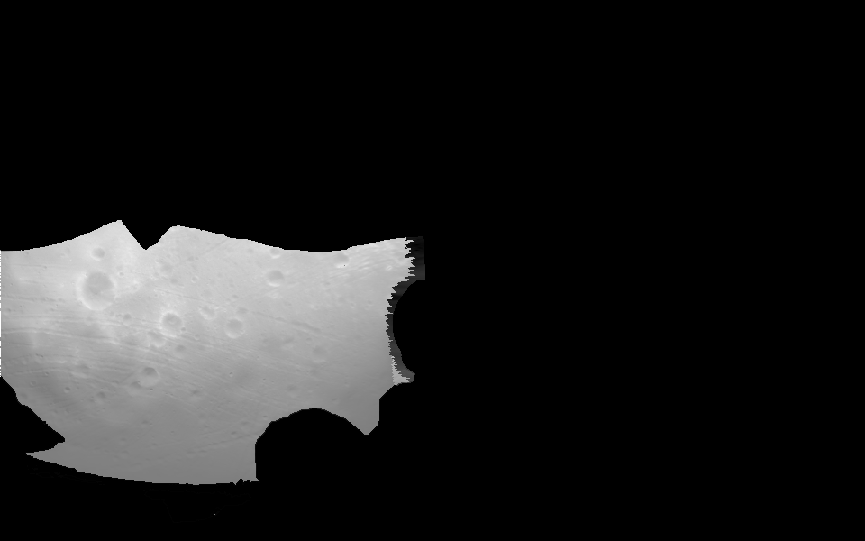
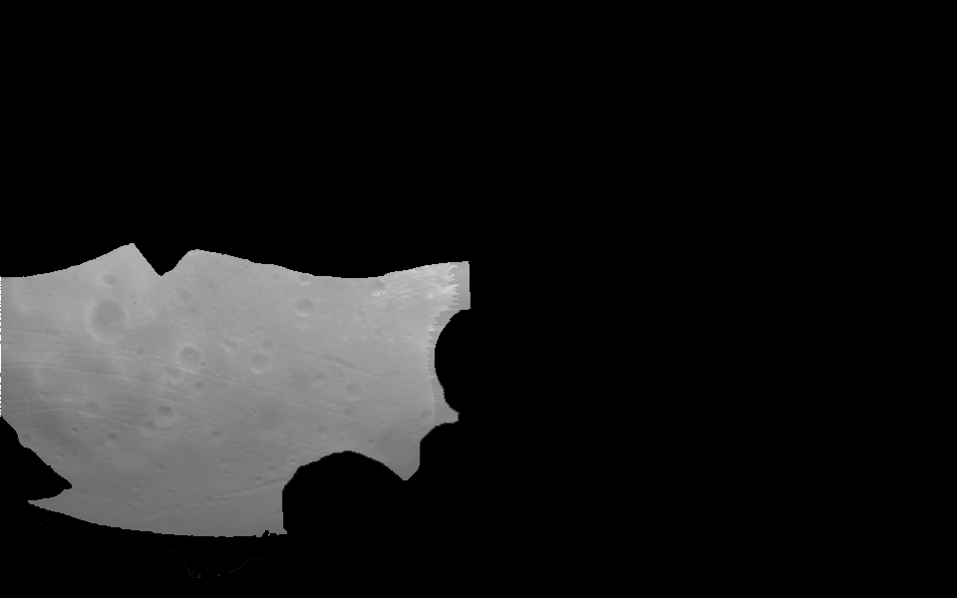
Photometric correction
Orbit 6906, ND channel, masked
Lambert: I/F = f(α) * μ₀
© DLR, M. Wählisch
Lommel-Seeliger: I/F = f(α) * [μ₀/(μ+μ₀)]
μ₀ = cos(i) & μ = cos(e)

Slide 11
…thank you for your attention

Slide 12
References
Albertz, J., Wiggenhagen, M., 2010: Guide for Photogrammetry and Remote Sensing. 5th ed. Heidelberg.
Greeley, R., Batson, R.M., (eds.), 1990: Planetary Mapping (= Cambridge Planetary Science Series 6). Cambridge.
Jaumann, R., Neukum, G., Behnke, T., et al. 2007: The high-resolution stereo camera (HRSC) experiment on Mars Express: Instrument aspects and experiment conduct from interplanetary cruise through the nominal mission. In: Planetary and Space Science, Vol. 55, pp. 928-952.
Noland, M., Veverka, J., 1976: The photometric functions of Phobos and Deimos, I. Disc-integrated photometry. In: Icarus, Vol. 28, No. 3, pp. 405-414.
Simonelli, P., et al., 1998: Photometric Properties of Phobos Surface Materials From Viking Images. In: Icarus, Vol. 131, No. 1, pp. 52-77.

