Slide 1
Physics of Volatiles on the Moon
Oded Aharonson^{1,2}
¹Weizmann Institute of Science
²California Institute of Technology
With contributions from N. Schorghofer / P. Hayne

Slide 2
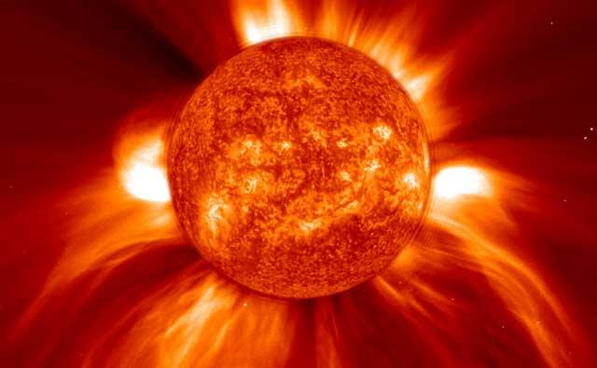
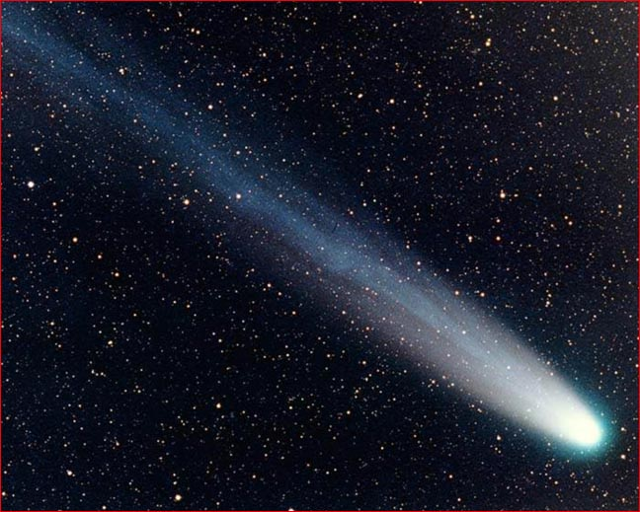
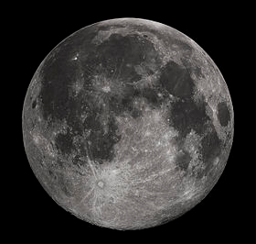
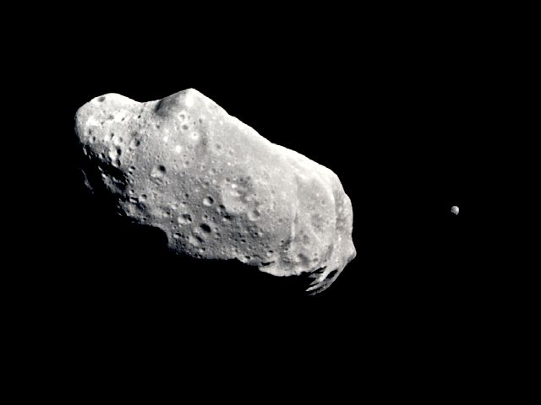
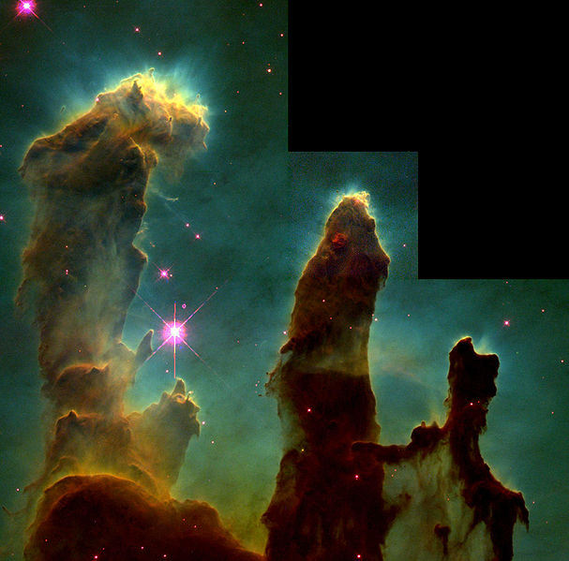
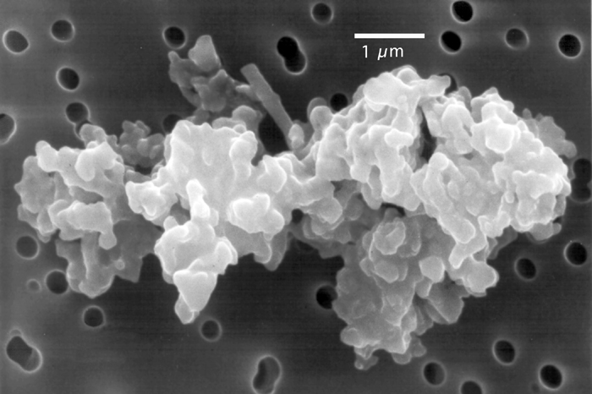
Solar
Wind
Comets
Moon
Asteroids
Giant
Molecular
Clouds
IDPs

Slide 3
Water Delivery to the Moon
Water delivery over the age of the Solar System, before any loss processes take place (from Moses et al., 1999)
Source Amount Delivered to Surface
Interplanetary Dust Particles 3 to 60 x 10¹³ kg
Meteoroids and Asteroids 0.4 to 20 x 10¹³ kg
Jupiter-family Comets 0.1 to 200 x 10¹³ kg
Halley-type Comets 0.2 to 200 x 10¹³ kg
Main Belt Comets ? (potentially very large)

Slide 4
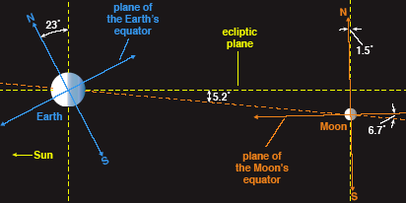
Lunar Orbit
  Low obliquity (axis tilt) of Moon leads to permanent shadow in craters at high latitude.

Slide 5
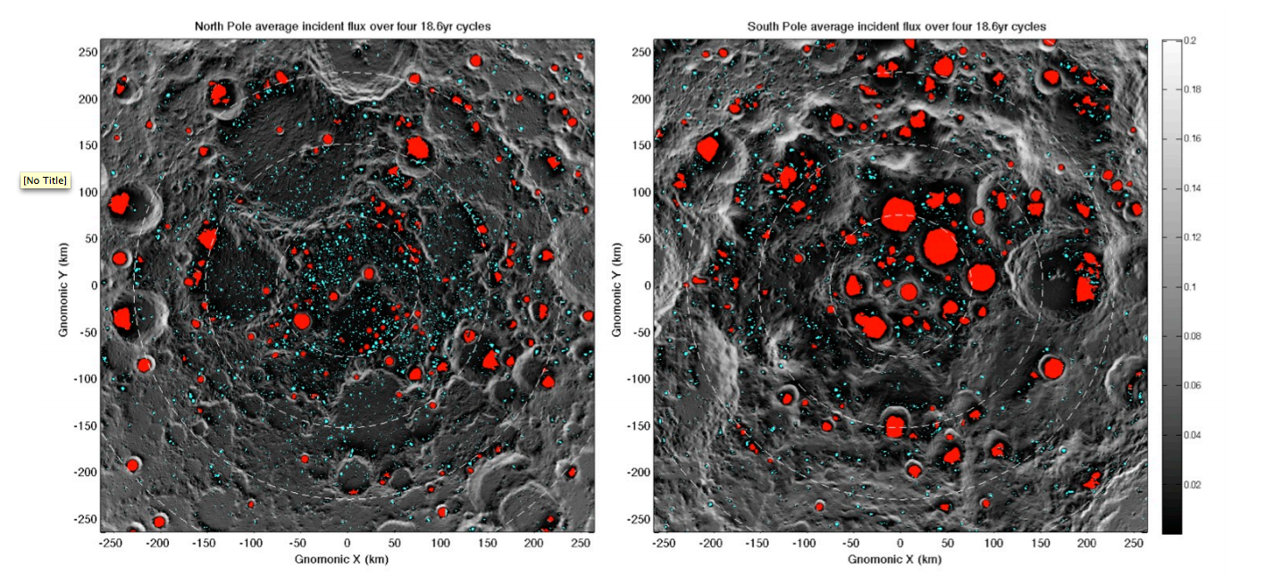
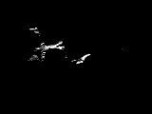
Mazarico et al. (2011)
Clementine photos taken over 1 lunar day
Notes:
150 largest PSRs in red, smaller ones in cyan
Northern (left, and southern (right)
Dashed circles are 2.5 degree steps
Animation of clementine photos

Slide 6
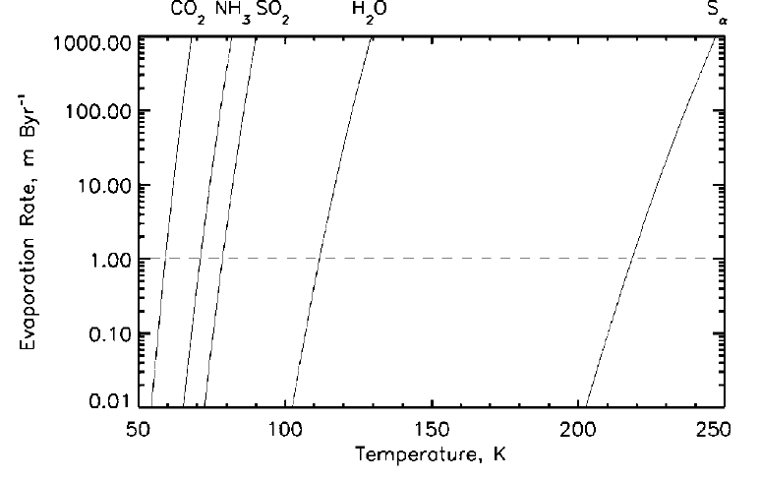
Cold Trapping
Sublimation rates highly non-linear with temperature
Loss from sunlit areas extremely fast; shadowed areas, extremely slow
Notes:
Dashed line marks survival of 1 m of ice for 1 By, for H2Othat’s 112K.

Slide 7
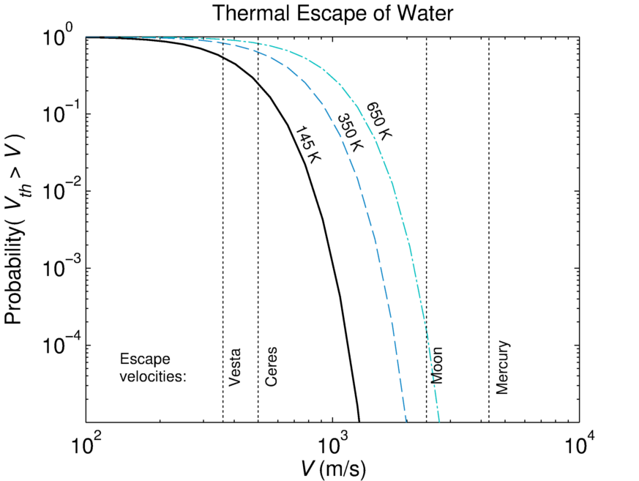
Inefficiency of Jeans Escape
Maxwell-Boltzmann velocity distribution:
Gravitational escape
→ Water strongly bound to the Moon by gravity, < 10⁻⁶ molecules escape per hop

Slide 8
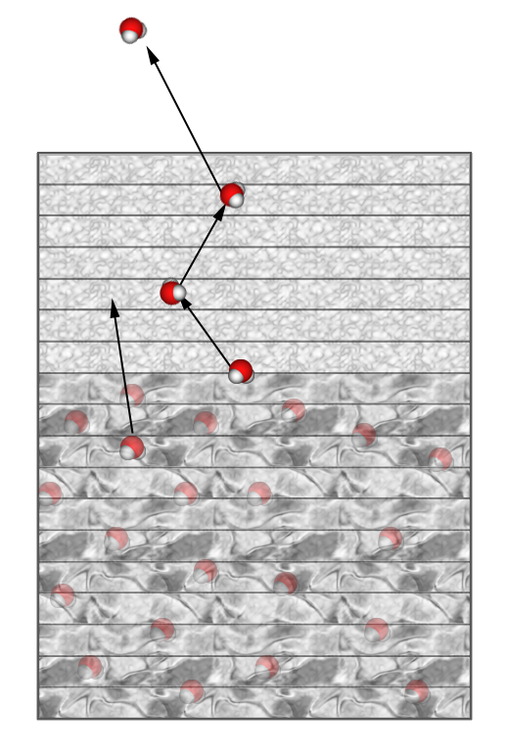
Ice Sublimation and Lag Formation
solar
IR emission to space
H₂O (g)
Ice table moves downward as ice sublimates and diffuses through desiccated regolith layer
Quasi-steady state can result if sources balance sinks, or if sublimation slow
Depth of ice table depends on insolation, regolith composition and porosity
conduction

Slide 9
Stability of Buried Ice
Schorghofer, 2008
Notes:
Grain diameter, porosity, amorphous ice vapor pressure → buried snow line(Schorghofer 2008)

Slide 10
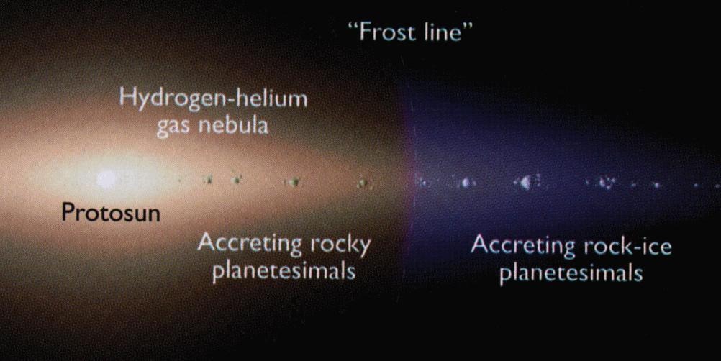
Of Snowlines
Conventional Snowline: Condensation temperature of H₂O in protoplanetary disk (145–170K)
“Buried Snowline”:
Below a mean surface temperature of about 145K, water ice will remain within the top few meters of the surface over the age of the solar system. A variation of ±10K (135–155K) captures a large range of soil layer properties.
Neither conventional nor buried snowline corresponds to an exact temperature. Also note, that buried T < conventional T.

Slide 11
Terminology
Adsorbed water: Binding between water and another substance
Physisorption (= physical adsorption), weakly bound, van der Waals forces
Chemisorption (= chemical adsorption), strongly bound, covalent bonding, can be dissociative i.e. breaks molecule apart
Hydration (water added to crystal structure)
Ice
  Crystalline, all the ice you have ever seen is in this form
  Amorphous, forms only at low temperature (<~140K)

Slide 12
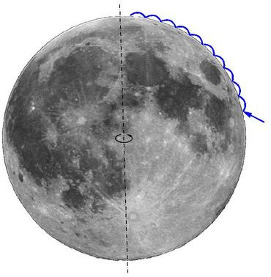
Classic Picture
  Energy is partitioned between thermal (kinetic) energy and gravitational (potential) energy;
  H is the height of a typical bounce of a single molecule:
  ½mv_{z}² = ½kT = mgH
  H = kT/(2mg) ≈ 50 km
g = surface acceleration (1.62 m/s²)
Ballistic flights are typically ~300 km long and last ~1 minute
Molecules move on the day side, stop on the night side.
Watson-Murray-Brown (1961)

Slide 13
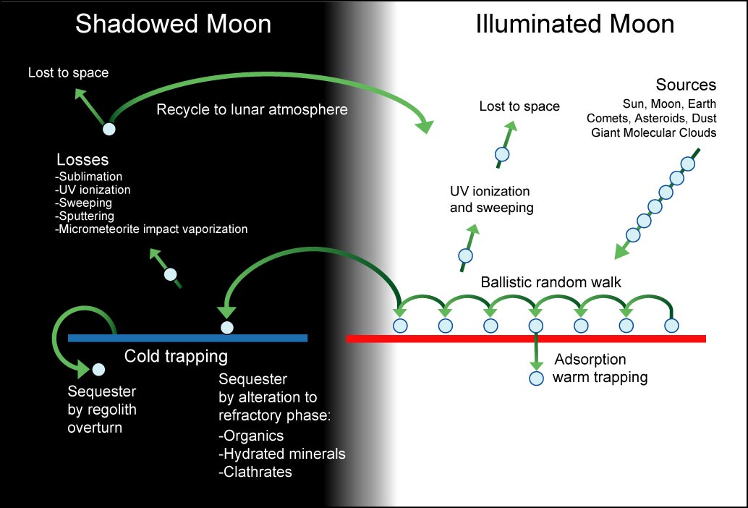
Lunar Water Cycle

Slide 14
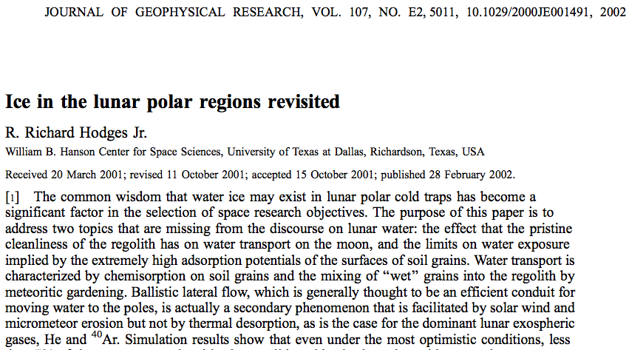
No Hopping due to Chemisorption?

Slide 15
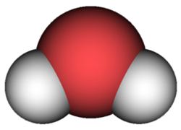
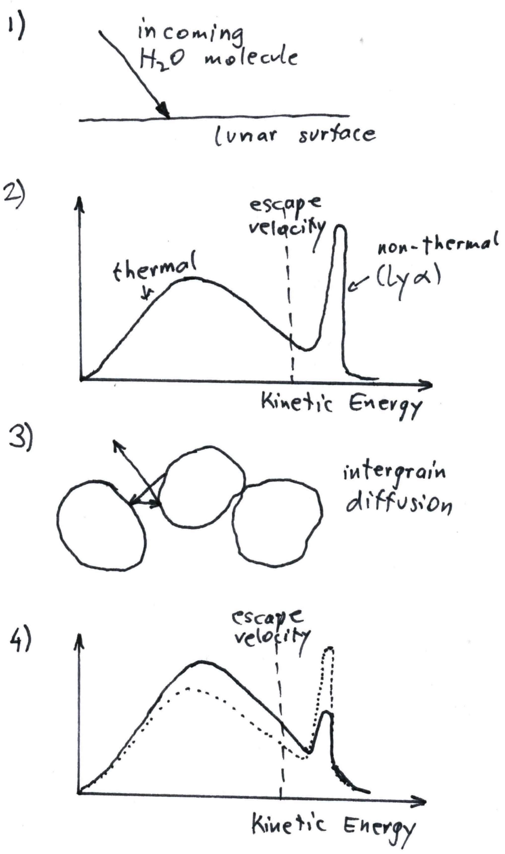
Incoming water molecules are trapped in surface defects
Some are released thermally, others super-thermally by Lyman-α
Some super-thermal molecules are slowed down by diffusion between grains
Hopping with thermal and super-thermal speeds
?
Lunar Surface
Non-thermal
(Ly α)

Slide 16
Monte Carlo Model: Spread of initial source
t=0
t=24 hours
t=1 month
H₂O molecules launched in random direction, with Maxwellian velocity components
Destruction rate 0.4%/hop ≈ lifetime 10⁵ s
Residence time is calculated from T and θ
Scheduling algorithm (event-driven code), processed in time order
Temperature model, 1-D at every longitude-latitude point, time step 1 hour
Follows past models (e.g. Butler 1997, ...)
Initially: 1 kmol of H₂O
Average of 100 hops until cold trapping

Slide 17
Dusk-Dawn Asymmetry
Continuous production of H₂O molecules at noon (by recombination of OH (Orlando et al. 2012))
More molecules at morning terminator than at evening terminator ➔ diurnal H₂O variations would be asymmetric, contrary to observations
Such an asymmetry is known for other volatiles: ²⁰Ne, ⁴⁰Ar (Hodges et al. 1973)

Slide 18
Ceres, Transport Effeciency
Fraction of initially 18t of ice that ends up at cold traps covering 0.5% of the surface area
Like the Moon and Mercury, Ceres is able to concentrate H₂O molecules globally into cold traps, if coldtraps exist.
 | Transport Efficiency
The Moon | 16%
Mercury | 17%
Ceres | 13%
Notes:
H2O molecules on Ceres hop further from on the Moon, so it takes fewer hops, each hop is more dangerous dynamically. But photodissociation is lower (r^2, x7) on Ceres.

Slide 19
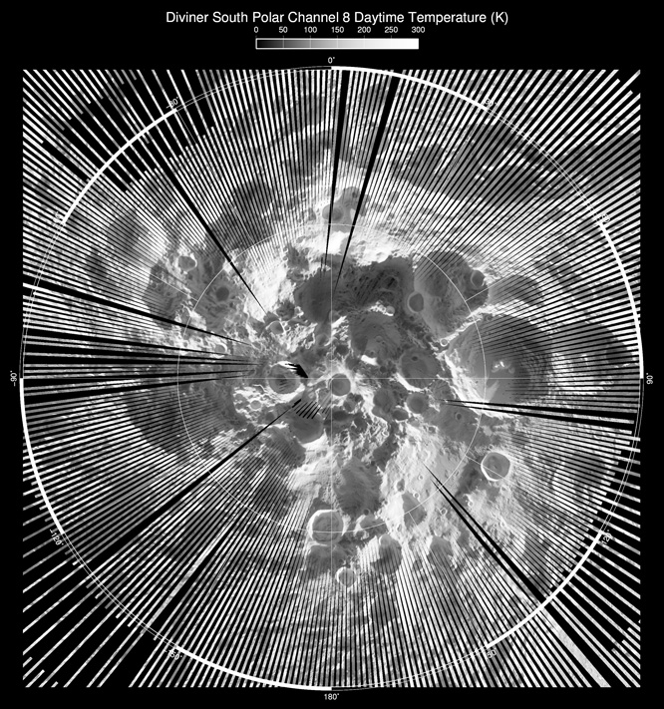
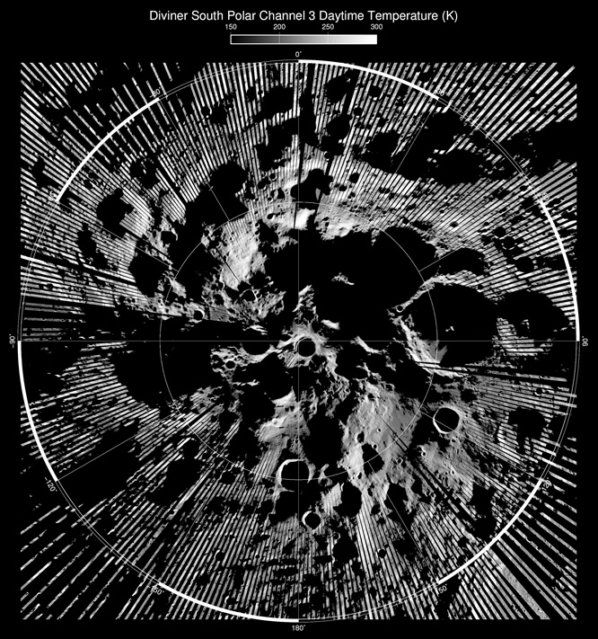
Notes:
Difficult to observe in visible light; even near- to mid-infrared difficult; broad, long-wavelength channels like Diviner’s can collect photons from the coldest, darkest polar regions

Slide 20
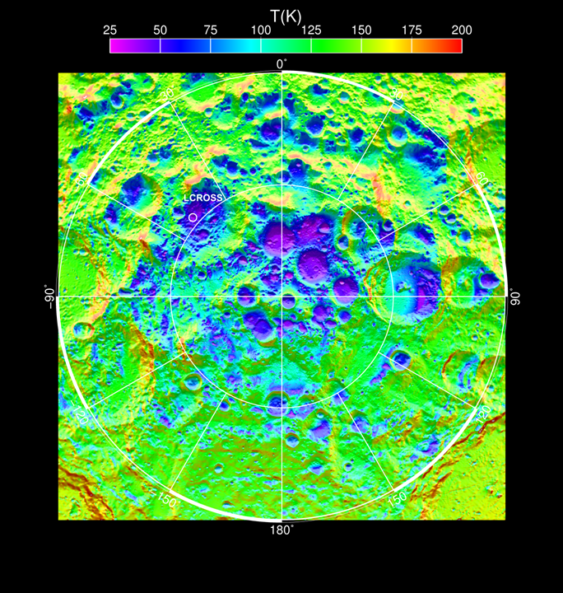
Mean annual temperature
Paige et al. (2010)

Slide 21
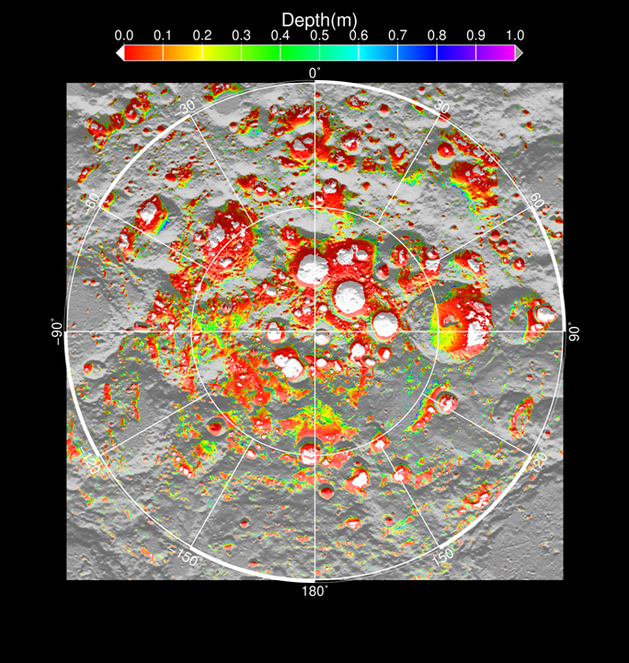
Paige et al. (2010)

Slide 22
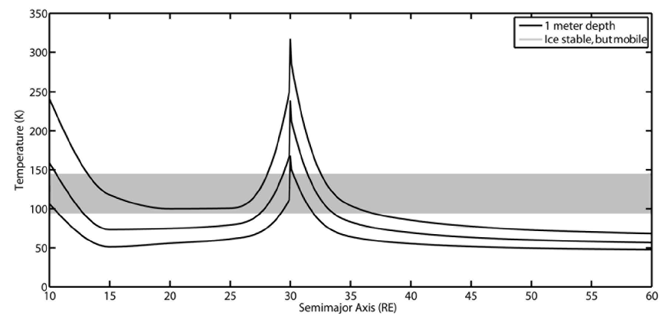
Obliquity Effects
unstable
time
Siegler et al. (2011) showed polar volatiles must be younger than the Cassini state transition (precise timing unknown), when Moon’s obliquity reached nearly 90°

Slide 23
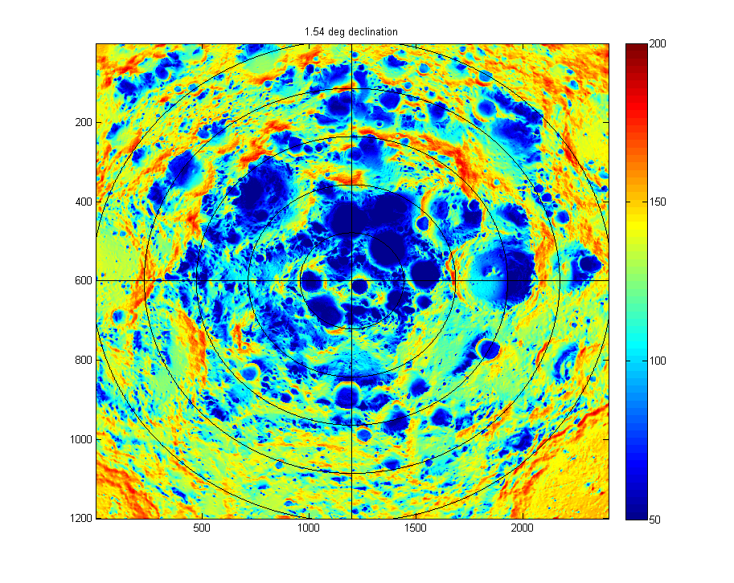
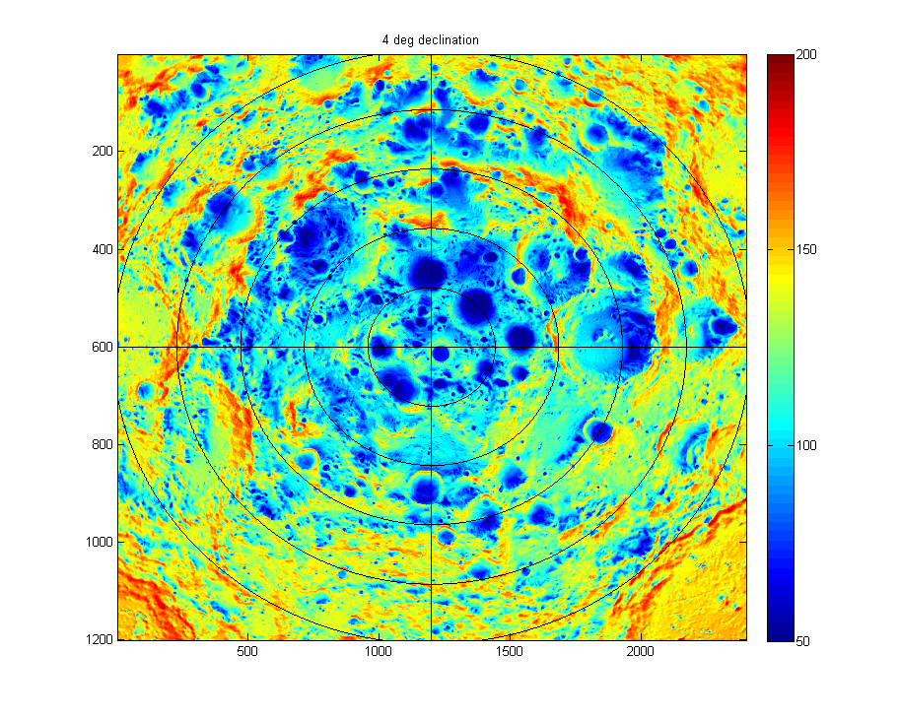
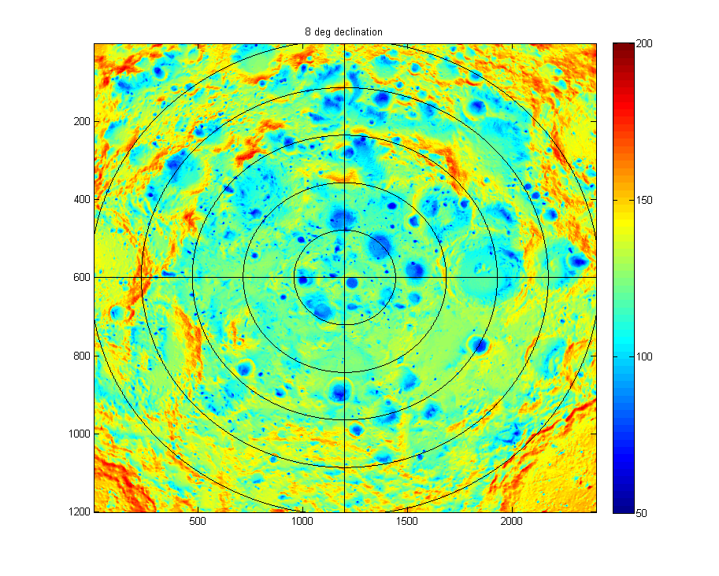
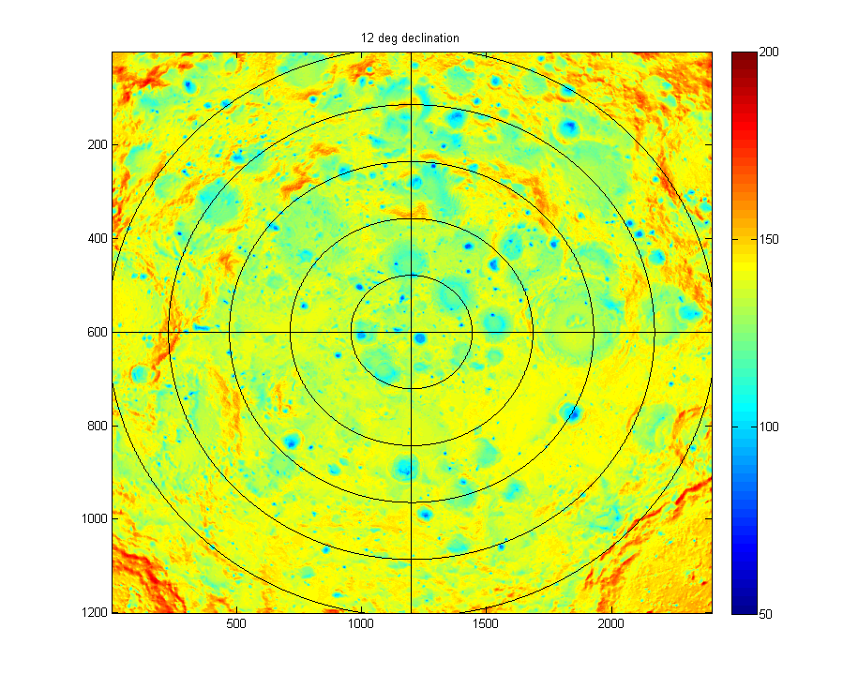
Mean Annual Temperature (Obliquity)
Present day: 1.5°
4°
8°
12°
Siegler et al. (2011)

Slide 24
OBSERVATIONS:
Neutrons, Radars, and Impact
Neutron Spectroscopy (Lunar Prospector & LRO)
Earth-based radar
Bistatic radar experiment by Clementine
MiniSAR (radar on LRO)
LCROSS Impact

Slide 25
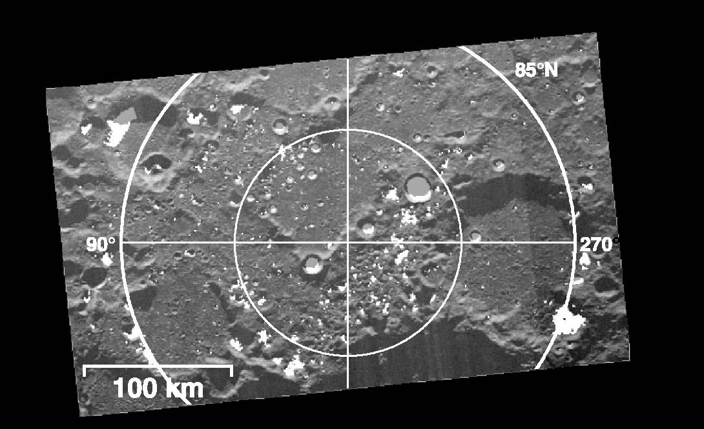
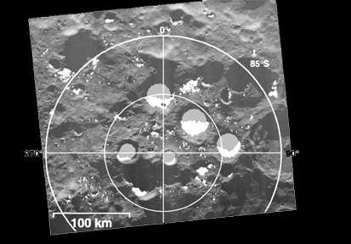
Polar Topography from Radar
North Pole
South Pole
(Margot et al., 1999)
Earth-Based RADAR topography maps of the lunar polar regions. White areas are permanent shadows observable from Earth. Grey areas are permanent shadows that are not observable from Earth.
Notes:
There are abundant permanently shadowed regions at both poles

Slide 26
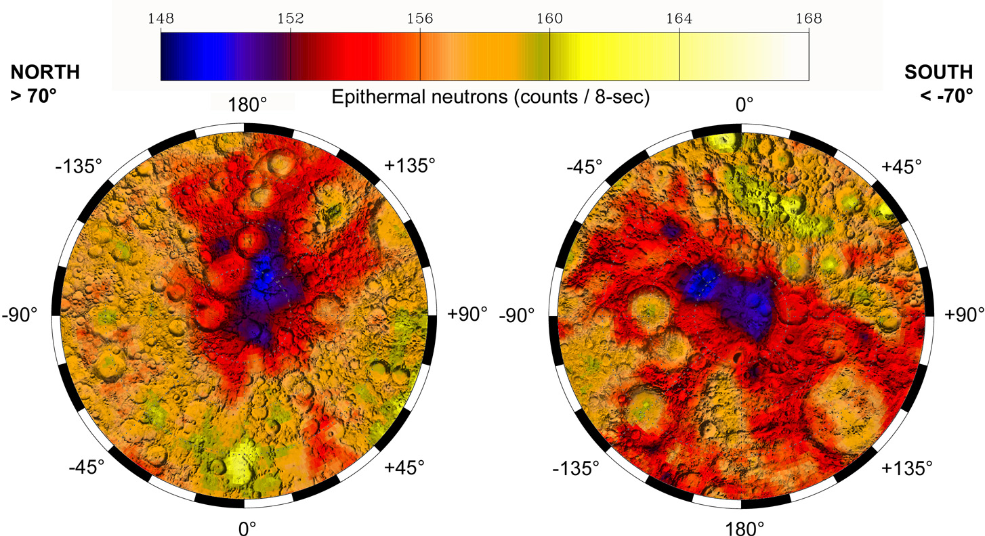
Lunar Prospector Neutron Spectrometer maps show small enhancements in hydrogen abundance in both polar regions
(Maurice et al, 2004)
The weak neutron signal implies a the presence of small quantities of near-surface hydrogen mixed with soil, or the presence of abundant deep hydrogen at > 1 meter depths; 1.5±0.8% H2O-equivalent hydrogen by weight (Feldman et al. 2000, Lawrence et al. 2006)

Slide 27
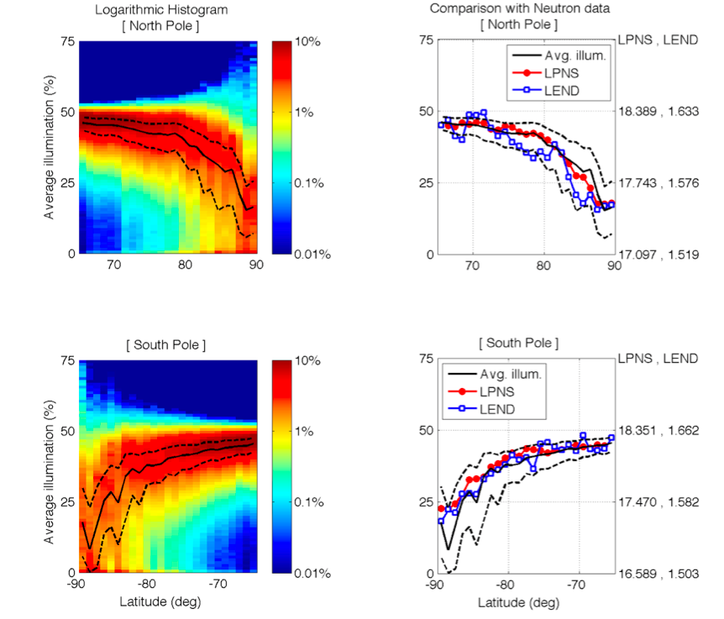

Slide 28
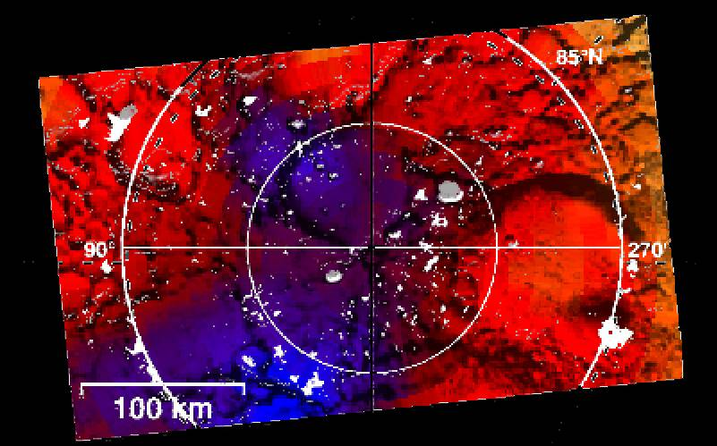
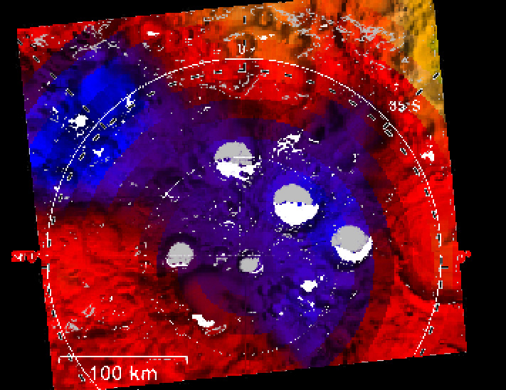
The locations of polar hydrogen enhancements are associated with the locations of suspected cold traps
North Pole
South Pole
Cabeus
U1
Shackelton
Not all suspected cold traps are associated with enhanced hydrogen
Aside from permanent shade, the most important parameter for lunar ice stability is the flux of indirect solar radiation and direct thermal radiation

Slide 29
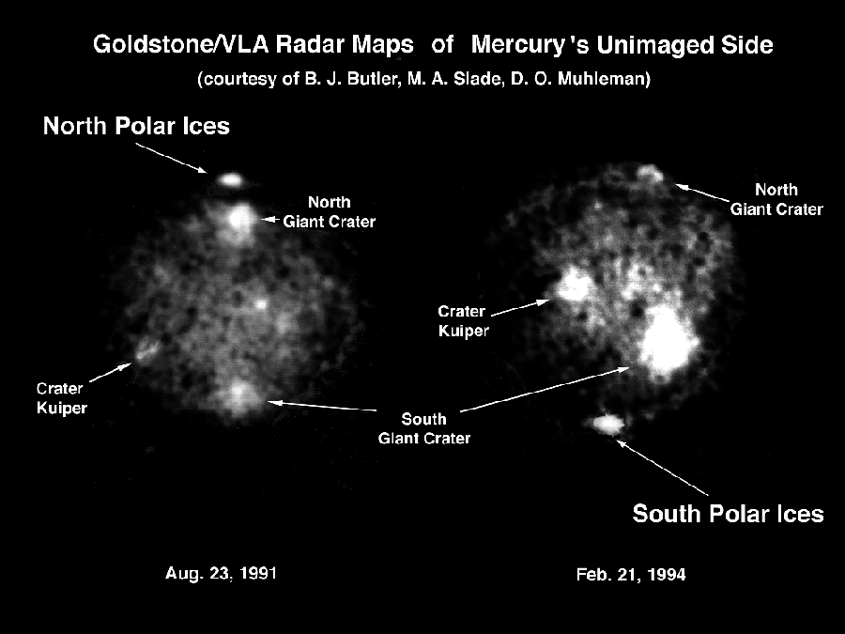

Slide 30
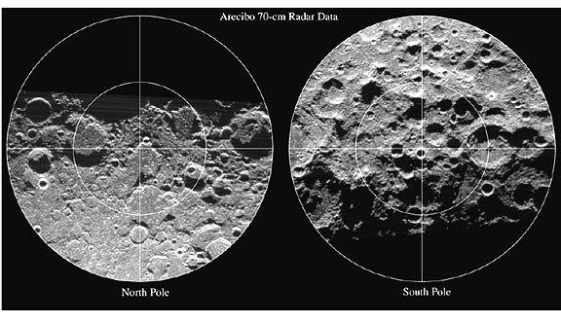
No radar evidence for the Moon

Slide 31
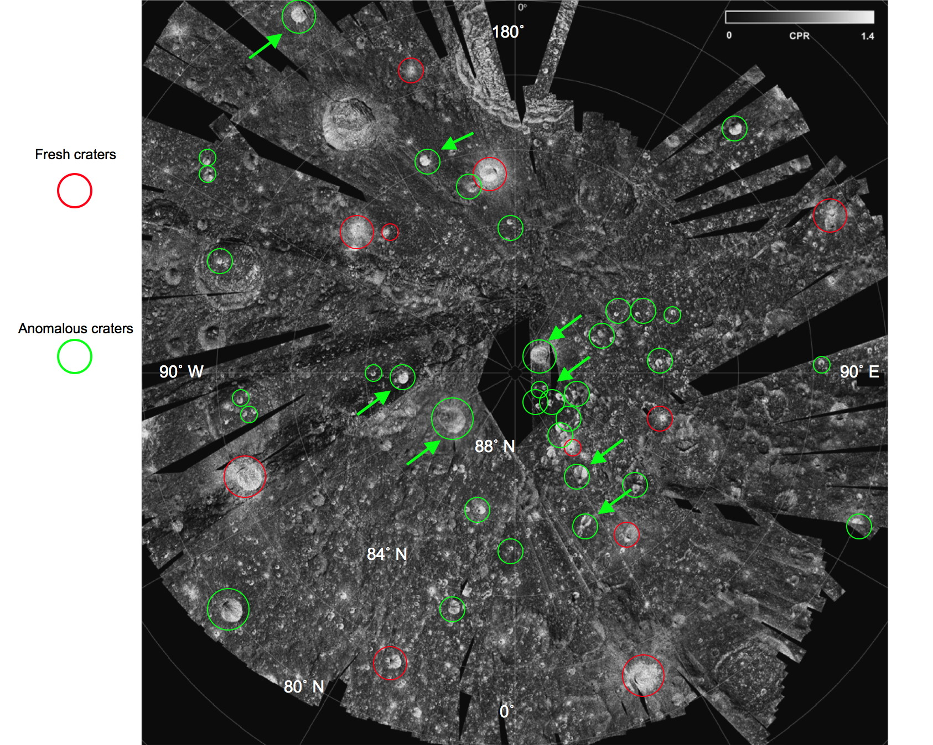
Mini-SAR map of the Circular Polarization Ratio (CPR) of the North Pole.
Fresh, “normal” craters (red circles): high CPR inside and outside their rims.
The “anomalous” craters (green circles) have high CPR within, but not outside their rims. Their interiors are also in permanent sun shadow.
These relations are consistent with the high CPR in this case being caused by water ice.
Notes:
Rocks and ejected blocks around fresh impact features cause a high CPR due to surface scattering.

Slide 32
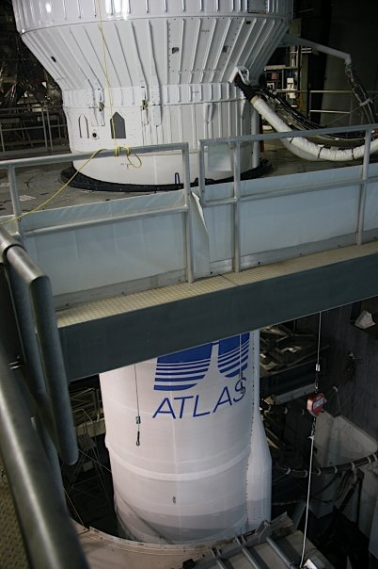
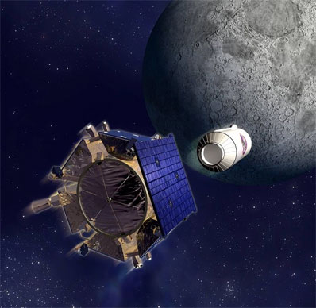
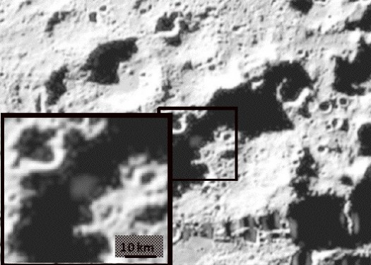
The LCROSS Mission
LCROSS Shepherding Spacecraft (SSc) equipped with a suite of remote sensing instruments, including UV/VIS and NIR spectrometers

Slide 33
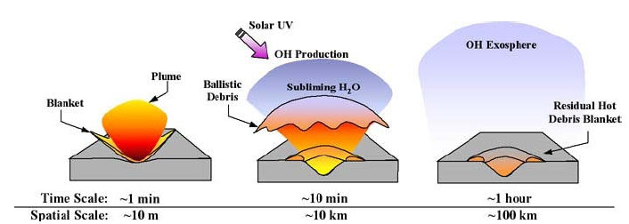
LCROSS Impact
(Lunar Crater Observation and Sensing Satellite)
Artifical impact in permanently shaded area (Cabeus crater); spectral observation of ejecta; Oct 9, 2009
5.6±2.9% H₂O by mass (Colaprete et al., 2010)
Also found (in order of abundance): H₂S, NH₃, SO₂, CH₃OH, C₂H₄, CO₂, CH₃OH, CH₄, OH

Slide 34
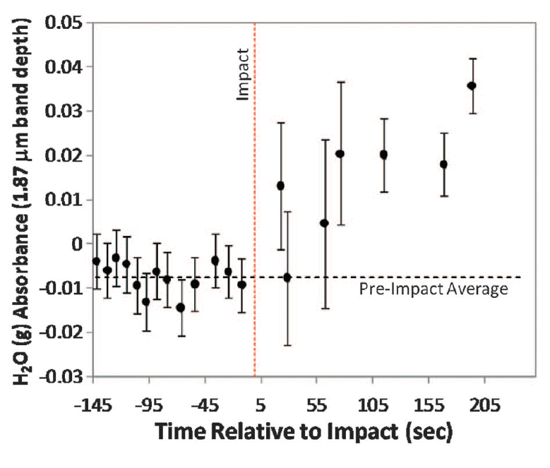
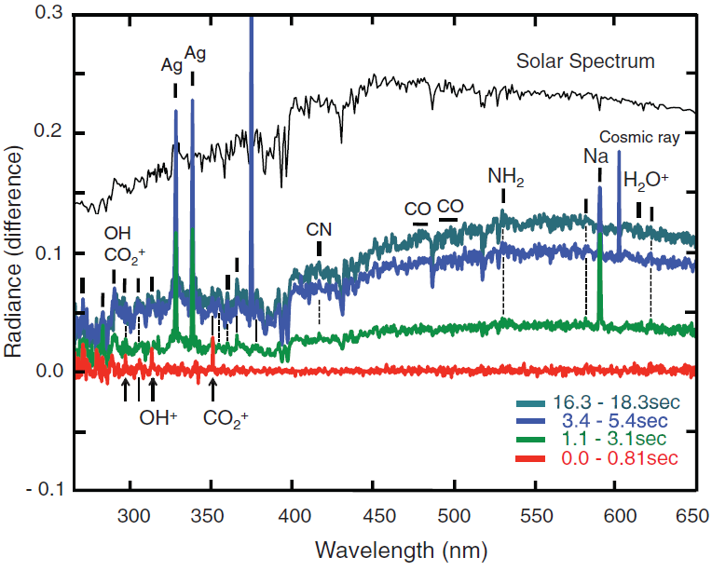
LCROSS Results
Water ice ~6% (±3%) abundance by mass
Many other volatiles: Ca, Mg, Na
Also mercury (don’t drink the water!), and silver (Ag, )

Slide 35
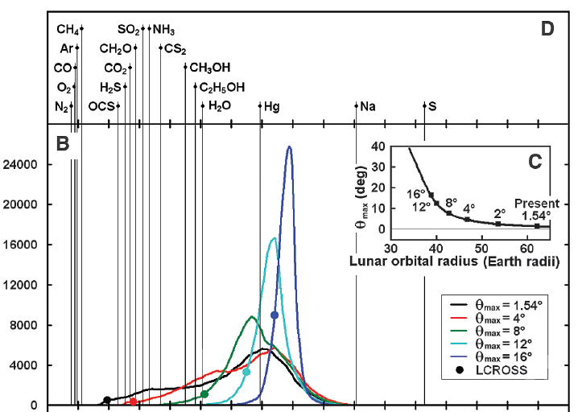


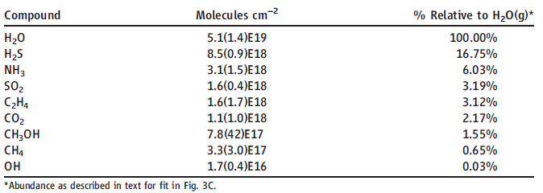
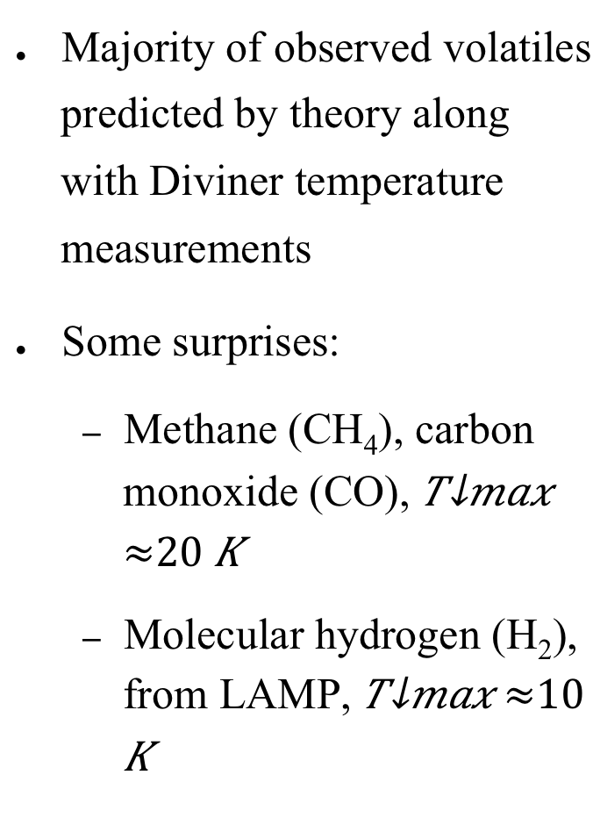
LCROSS Results
Majority of observed volatiles predicted by theory along with Diviner temperature measurements
Some surprises:
  Methane (CH₄), carbon monoxide (CO),
  Molecular hydrogen (H₂), from LAMP,
?

Slide 36
Summary of Polar H2O Observations
Excess of 1.5±0.8% H2O-equivalent hydrogen by weight (Feldman et al. 2000) - Lunar Prospector Neutron Spectrometer
Several % H2O confirmed by LEND (Mitrofanov et al, 2010)
Bistatic radar experiment by Clementine also suggested the presence of water ice (Nozette et al., 1996).
Radar evidence for ice on both poles of Mercury; none on the Moon (thus <<100%)
LCROSS Impact: 5.6±2.9% H2O by mass (Colaprete et al., 2010)
Evidence from MiniSAR

Slide 37
ADSORBED H₂O AND OH
Observed spectroscopically by three spacecraft
M3 (Moon Minearalogy Mapper Spectrometer) on Chandrayaan-1 (Pieters et al., 2009)
EPOXI flyby (Sunshine et al., 2009)
Cassini flyby (Clark 2009)
H₂O = Water
OH = Hydroxyl
(Has also been suggested a long time ago.)

Slide 38
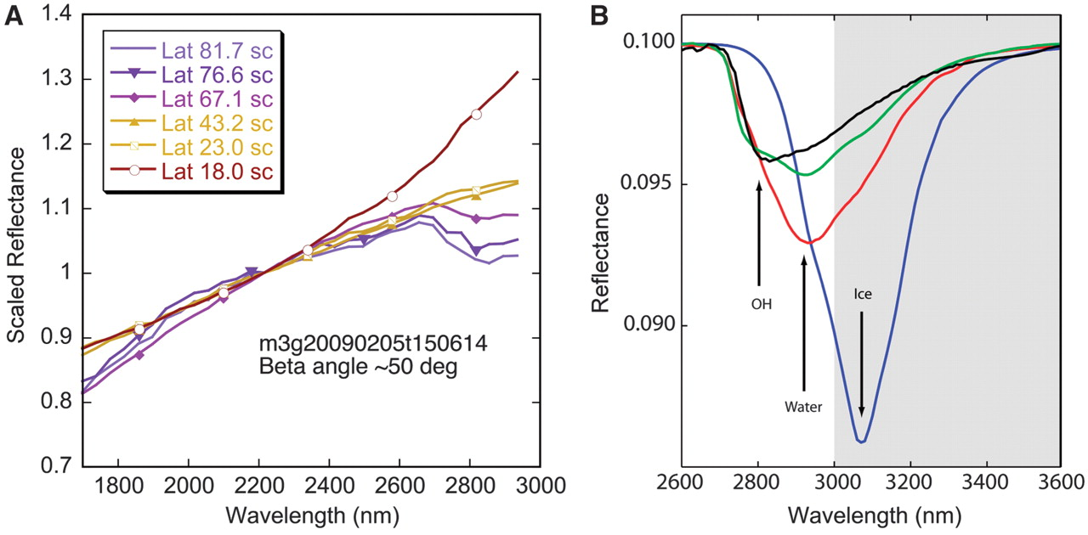
Scaled reflectance spectra for M3 image strip
(A) The strongest detected 3-μm feature (~10%) occurs at cool, high latitudes, and the measured strength gradually decreases to zero toward mid-latitudes. At lower latitudes (18°), the additional thermal emission component becomes evident at wavelengths above ~2200 nm. (B) Model near-infrared reflectance spectra of H2O and OH. These spectra are highly dependent on physical state. The shaded area extends beyond the spectral range of M3. (Pieters et al., 2009)
Notes:
(A) Scaled reflectance spectra for M3 image strip M3G200902005T150614. All spectra are 7-by-7–pixel averages, and no thermal emission has been removed to allow the measured flux to be compared. The strongest detected 3-μm feature (~10%) occurs at cool, high latitudes, and the measured strength gradually decreases to zero toward mid-latitudes (where thermal emission is necessarily less well constrained by M3). At lower latitudes (18°), the additional thermal emission component becomes evident at wavelengths above ~2200 nm (14, 15). (B) Model near-infrared reflectance spectra of H2O and OH applicable for lunar comparisons. These spectra are highly dependent on physical state. A model of a thin layer of H2O water (red) and ice (blue) on a 10% reflective surface equivalent to ~1000-ppm abundance is distinct from anorthite (green) and a lunar glass analog (black). The shaded area extends beyond the spectral range of M3. Calculations are based on optical constants from (27–29), assuming no scattering in the H2O or OH and with a 100-μm path length within the substrate.

Slide 39
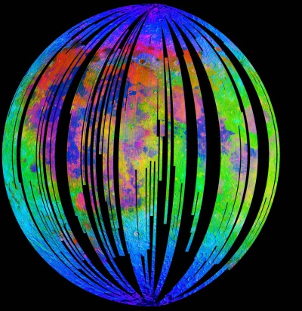
Map of Water and Hydroxyl from M3
Red = 2-micron pyroxene absorption band depth
Green = 2.4-micron apparent reflectance
Blue = absorptions due to water and hydroxyl.
(Clark et al., 2010)
Notes:
All blue, cyan, magenta and pink areas contain adsorbed water and/or hydroxyl, while red, green, yellow and orange contain little to no water or hydroxyl.

Slide 40
Summary
Volatiles hop along ballistic trajectories, and H₂O may be able to survive in cold (<110K) permanently shaded areas near the lunar poles
Significant observational evidence for ice in permanently shaded areas near both poles of the Moon; ~ several weight percent
Hydroxyl and water, probably adsorbed, in polar latitudes, but—
Water mobile on a timescale of a lunar day is difficult to reconcile with theory/observations

Slide 42
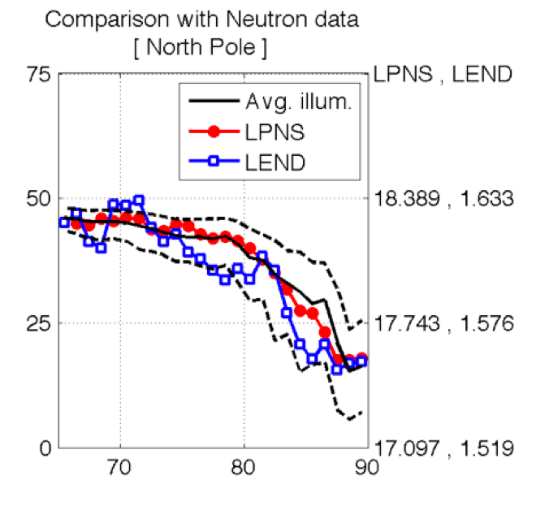
Mazarico (pers. comm.)

Slide 43
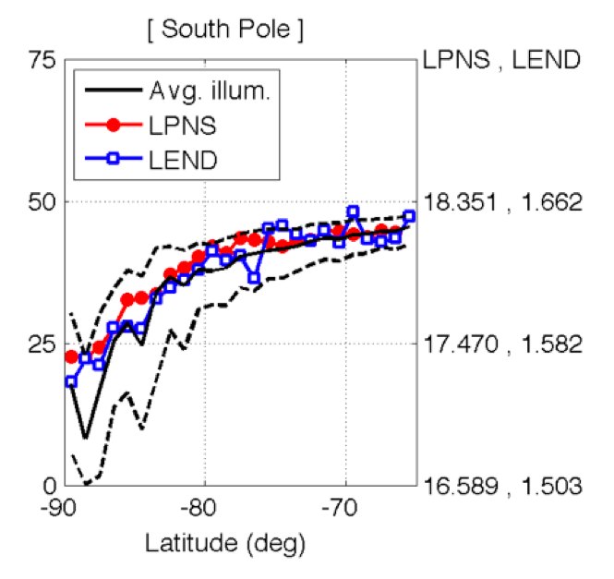
Mazarico (pers. comm.)

Slide 44
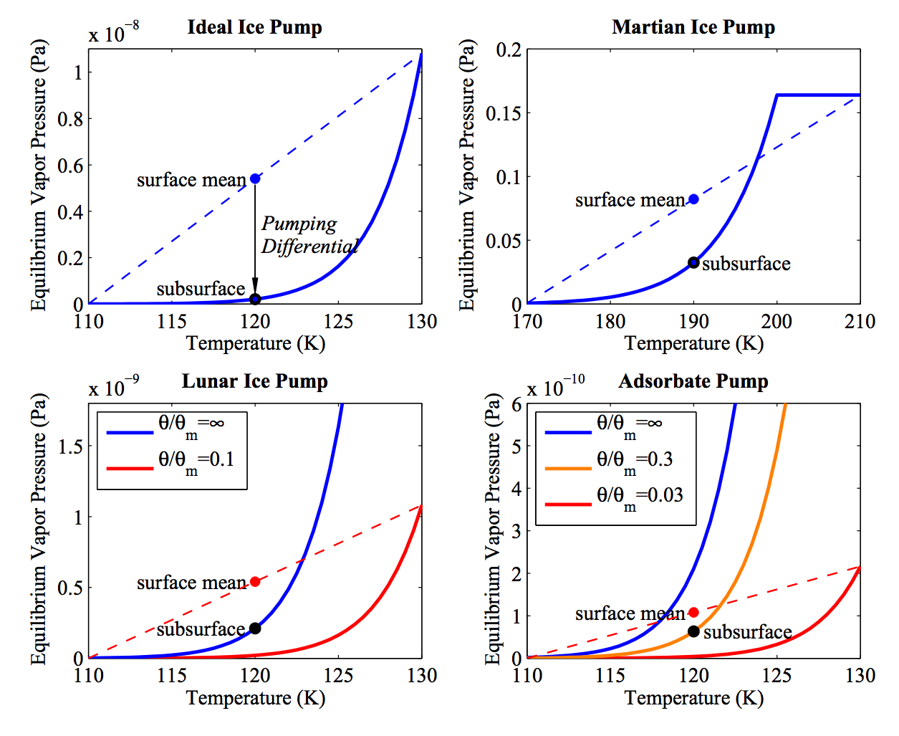

Slide 45


Desorption Experiments
Fe-rich lunar analog glass
JSC-1A
albite (feldspar)
Hibbitts et al. (2011): glass is hydrophobic;
other materials can chemisorb even at high temperatures

Slide 46

Paul G. Lucey

Slide 47

Diviner Spectral Channels:
2 solar channels: 0.35 – 2.8 μm
7 infrared channels:
  7.80 μm
  8.25 μm
  8.55 μm
  13-23 μm
  25-41 μm
  50-100 μm
  100-400 μm
Diviner typically operates in “push-broom” mode
~ 4 km footprint
Diviner’s independent two-axis actuators allow targeting independent of the spacecraft

Slide 48
Adsorption Isotherm
15°C, lunar sample
approximately reversible
adsorption rate = desorption rate

Slide 49
Adsorption Isotherm
➔ Desorption Rate
Sublimation rate of ice into vacuum:
Desorption rate of adsorbed water:
P₀ ... saturation vapor pressure of ice P₀(T)
m ... mass of molecule
k ... Boltzmann constant
T ... temperature
θ ... adsorbate coverage

