Slide 1
Golubev Yu.F., Grushevskii A.V., Koryanov V.V., Tuchin A.G. golubev@keldysh.ru A method of orbits designing using gravity assist maneuvers to the landing on the Jupiter’s moon Ganymede
Keldysh Institute of Applied Mathematics Russian Academy of Sciences
The Third Moscow Solar System Symposium (3M-S³)
Space Research Institute Moscow, Russia
October 11, 2012

Slide 2
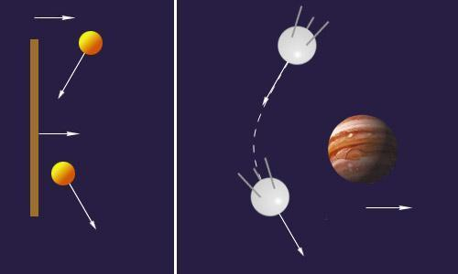
CB-Classic Billiard
Rebound
Gravity assist
GB-Gravitational Billiard

Slide 3
Initial idea (analogy) QGB-Quazi-Gravitational Billiard (Earth)
Golubev Yu.F., Grushevskii A.V., Highrullin R.Z. (1993)
Indicatrix for various out values of exit tractory angles
Atmosphere Reboundes. Indicatrix method (IM)

Slide 4
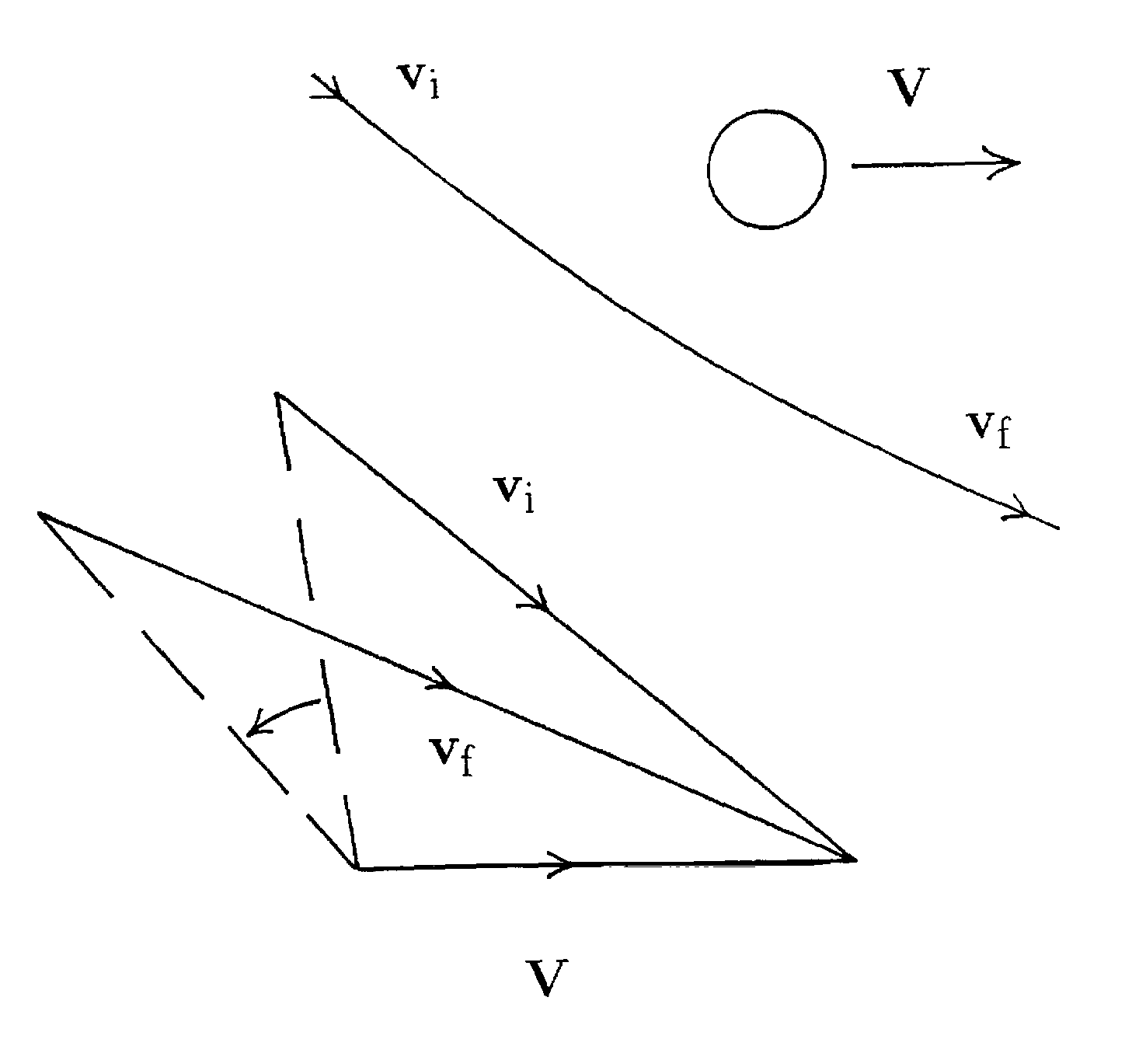
Quazi-Gravitational Billiard in the Jupiter moons tours
Gravity assist maneuver

Slide 5
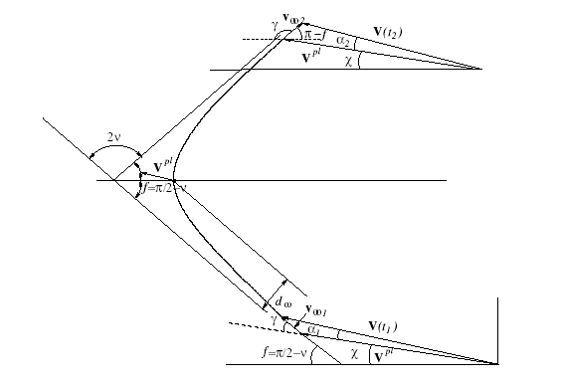
Gravity assist maneuver
General formulae

Slide 6
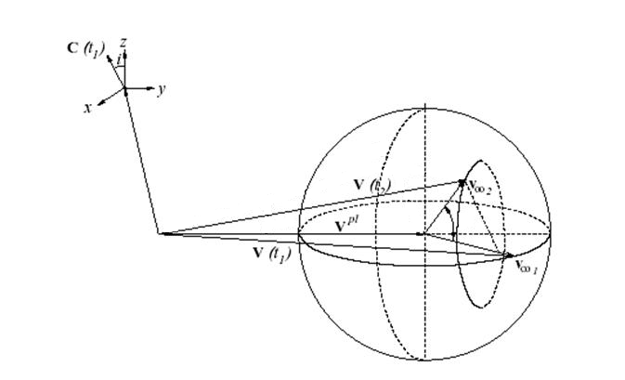
3D gravity assist maneuver

Slide 7
Indicatrix Method for Gravity Assist
Gravity assist area is much less than trajectory size (rebound)
2. A priori bank of rebounds
3. The wave fronts synthesis

Slide 8
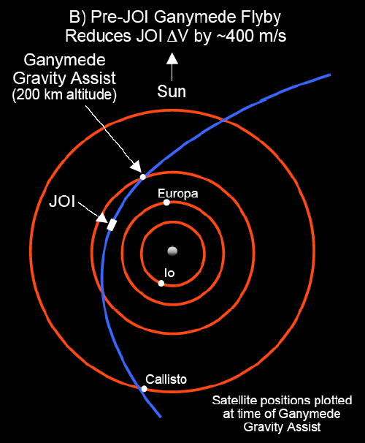
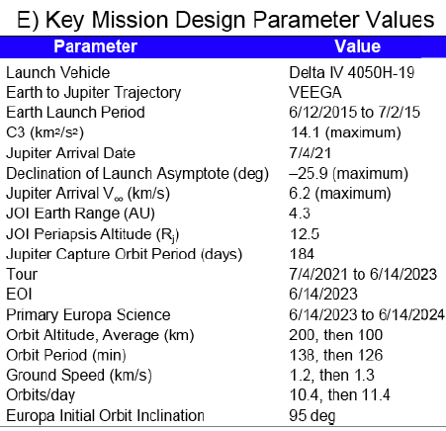
The Europa Jupiter System Mission – Laplace (EJSM/Laplace)

Slide 9
EJSM/Laplace- Russian part Ganymede landing
Satellite | Orbital period of SC after the satellite flyby rated to satellite’s orbital period | Number of rounds after a flyby | Expenses of characteristic velocity, m/s
Ganymede | 6 | 1 | 6.8
Ganymede | 5 | 2 | 5.1
Ganymede | 4 | 1 | 19.9
Ganymede | 3 | 1 | 5.1
Ganymede | 2.5 | 2 | 5.9
Ganymede | 2 | 1 | 6.8
Using:
Refined Flyby Model
ESTK complex by Ballistic Center KIAM RAS
Navigation and Ancillary Information Facility (NAIF)- NASA — used data will be refined during NASA mission

Slide 10
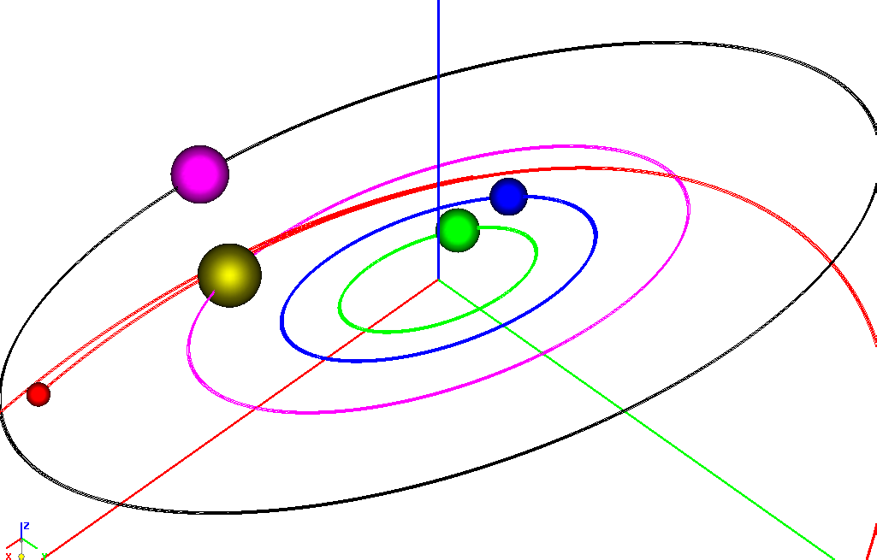
1-st maneuver
Callisto
Europa
IO
Ganymede
Time of minimal distance reaching | 2022/02/17 20:39:29.671
Minimal distance | 18.119618 1000 km
Height of pericenter of flyby hyperbola | 15.485618 1000 km
Asymptotic velocity | 6.794698
Change of velocity relatively to Jupiter | -0.040897
Period after flyby of GANYMEDE | 42.915096 days
Distance in pericenter rated to Jupiter’s radius | 11.503787
Eccentricity after flyby | 0.767555
Velocity in pericenter after flyby | 16.511564
Velocity in apocenter after flyby | 2.171381
Vx=0.000755, Vy= 0.005958, Vz=0.003207, |V|=0.006808

Slide 11
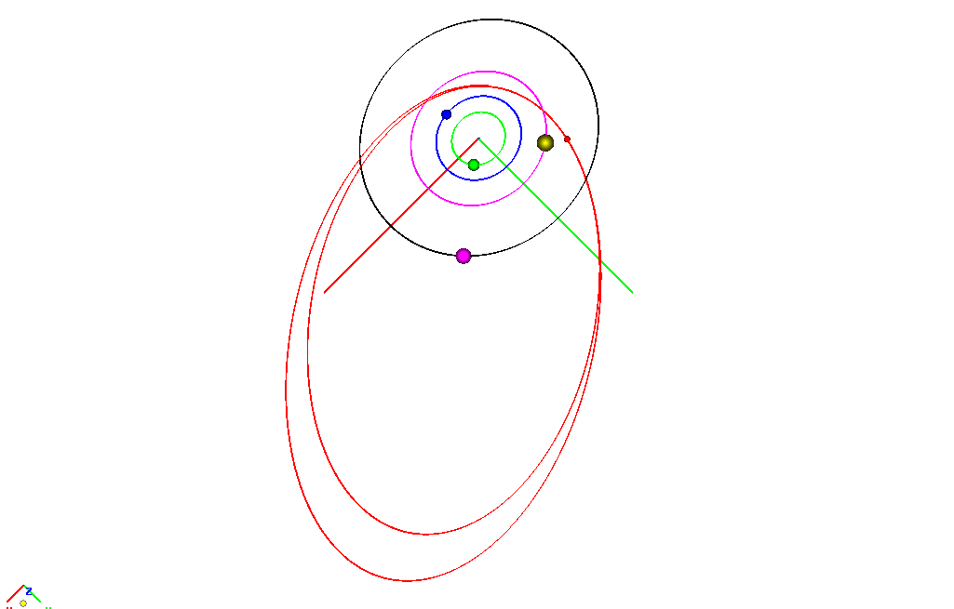
2-nd maneuver
Time of minimal distance reaching | 2022/04/01 18:58:44.126
Minimal distance | 13.702676 1000 km
Height of pericenter of flyby hyperbola | 11.068676 1000 km
Asymptotic velocity | 6.761808
Change of velocity relatively to Jupiter | -0.046064
Period after flyby of GANYMEDE | 35.762581 days
Distance in pericenter rated to Jupiter’s radius | 11.268810
Eccentricity after flyby | 0.742874
Velocity in pericenter after flyby | 16.565945
Velocity in apocenter after flyby | 2.443969
Vx-0.004218, Vy=0.002570, Vz=0.001342, |V|=0.005118

Slide 12
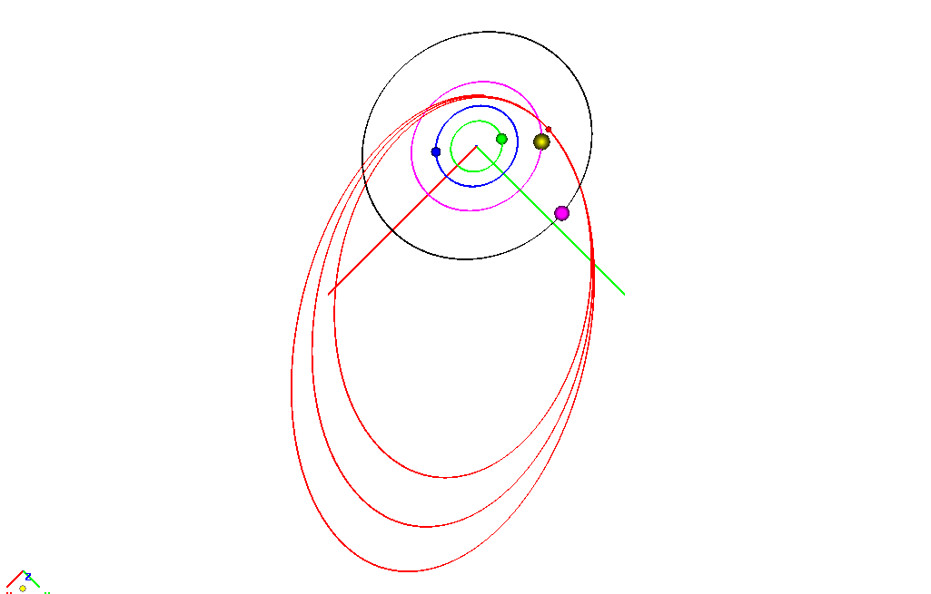
3-rd maneuver
Time of minimal distance reaching | 2022/06/12 08:07:50.533
Minimal distance | 9.464318 1000 km
Height of pericenter of flyby hyperbola | 6.830318 1000 km
Asymptotic velocity | 6.747614
Change of velocity relatively to Jupiter | -0.057707
Period after flyby of GANYMEDE | 28.610065 days
Distance in pericenter rated to Jupiter’s radius | 10.908290
Eccentricity after flyby | 0.711178
Velocity in pericenter after flyby | 16.683664
Velocity in apocenter after flyby | 2.815964
Vx=-0.014865, Vy=0.012230, Vz=0.004934, |V|=0.019872

Slide 13
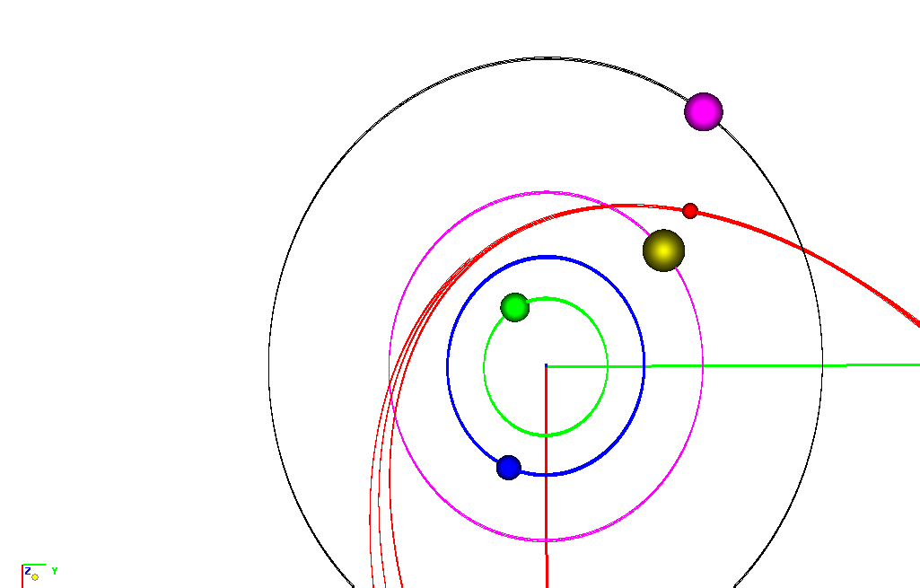
4-th maneuver
Time of minimal distance reaching | 2022/07/10 22:57:18.963
Minimal distance | 6.338138 1000 km
Height of pericenter of flyby hyperbola | 3.704138 1000 km
Asymptotic velocity | 6.724214
Change of velocity relatively to Jupiter | -0.078352
Period after flyby of GANYMEDE | 21.457549 days
Distance in pericenter rated to Jupiter’s radius | 10.356952
Eccentricity after flyby | 0.667801
Velocity in pericenter after flyby | 16.903565
Velocity in apocenter after flyby | 3.366919
Vx=-0.003701, Vy=0.003109, Vz=0.001477, |V|=0.005055

Slide 14
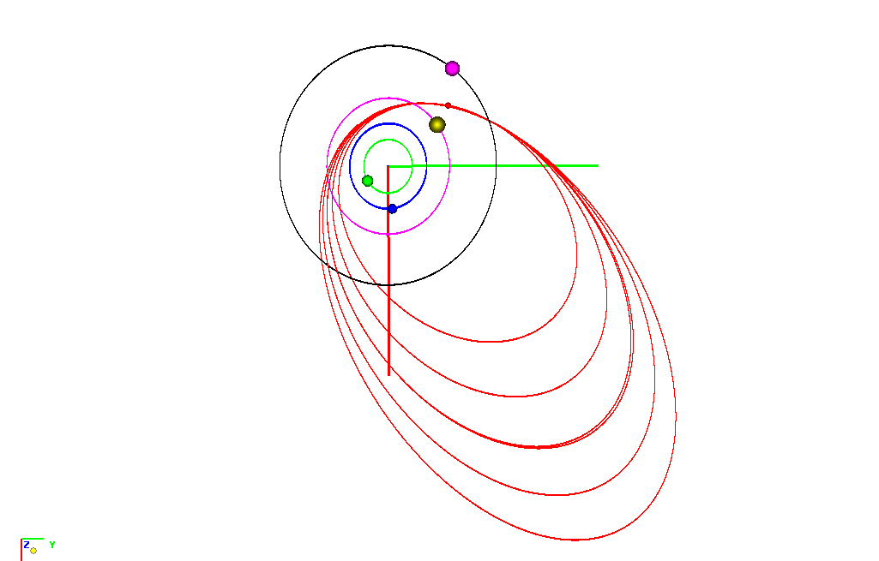
5-th maneuver
Time of minimal distance reaching | 2022/08/01 09:56:58.574
Minimal distance | 8.641858 1000 km
Height of pericenter of flyby hyperbola | 6.007858 1000 km
Asymptotic velocity | 6.746652
Change of velocity relatively to Jupiter | -0.068217
Period after flyby of GANYMEDE | 17.881290 days
Distance in pericenter rated to Jupiter’s radius | 9.929413
Eccentricity after flyby | 0.640352
Velocity in pericenter after flyby | 17.120993
Velocity in apocenter after flyby | 3.753786
Vx=-0.001707, Vy=0.005016, Vz=0.002694, |V|=0.005944

Slide 15
6-th maneuver
Time of minimal distance reaching | 2022/09/06 04:29:38.081
Minimal distance | 6.051283 1000 km
Height of pericenter of flyby hyperbola | 3.417283 1000 km
Asymptotic velocity | 6.727114
Change of velocity relatively to Jupiter | -0.095345
Period after flyby of GANYMEDE | 14.305032 days
Distance in pericenter rated to Jupiter’s radius | 9.273662
Eccentricity after flyby | 0.610227
Velocity in pericenter after flyby | 17.552545
Velocity in apocenter after flyby | 4.248788
Vx=-0.006027, Vy=0.003142, Vz=-0.000433, |V|=0.006811
Indicatrix method (IM) allows to significantly
optimize the scheme of gravity assists construction

Slide 16
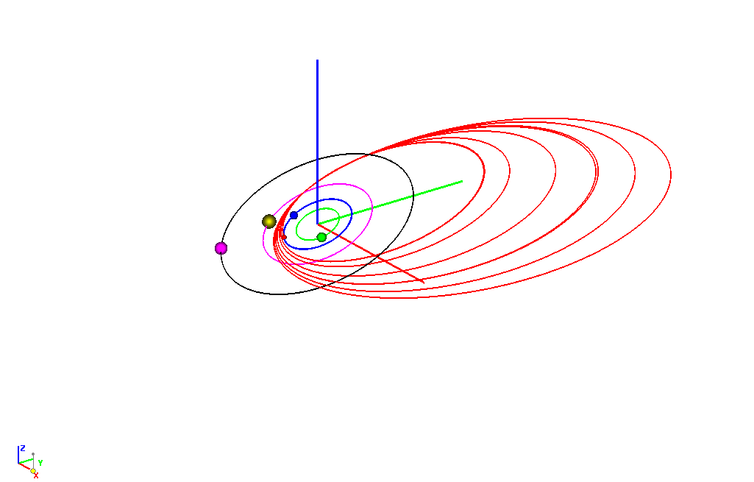
6-th maneuver

Slide 17
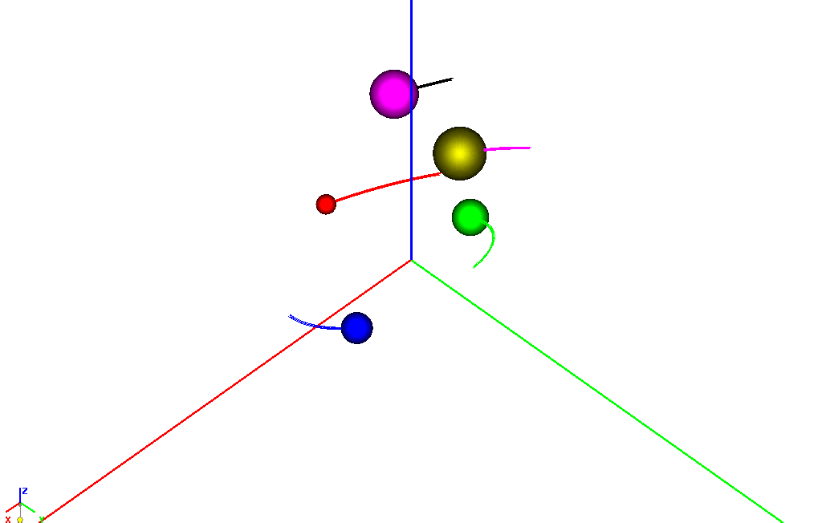
Ganymede tour: fine calculation (Indicatrix method not used)

Slide 18
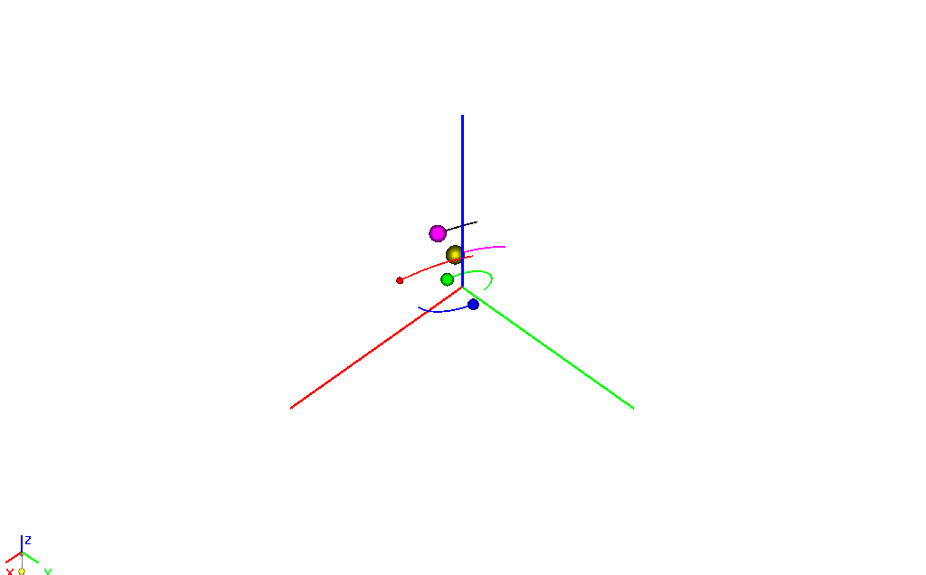
Tour selection problem, Indicatrix Method (IM). Phase beams

Slide 19
Thanks for attention

