Slide 1
WATER-ICE CONTENT
IN TITAN AND CALLISTO
Dunaeva A.N., Kronrod V.A., Kuskov O.L.
Vernadsky Institute of Geochemistry and Analytical Chemistry, Russian Academy of Sciences,
Moscow, Russia

Slide 2
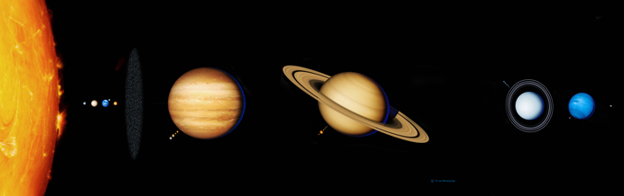
Jupiter
Saturn
Callisto
Titan
Callisto and Titan:
were formed in the outer zones of their central planets (Jupiter and Saturn);
are the largest and well-formed satellites of gas giant planets;
are regular satellites (their orbits and rotation are the same as the rotation of associated central planets);
satellites rotation is synchronous with their orbits (like our Moon);
low density of the satellites suggests that they could contain remarkable amounts of H₂O.

Slide 3
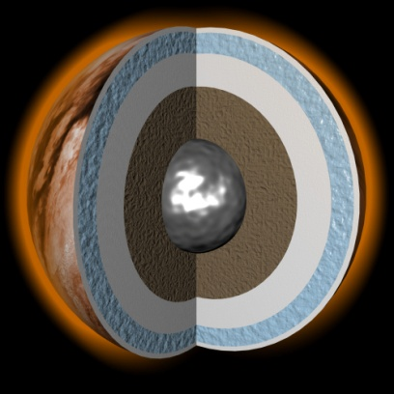
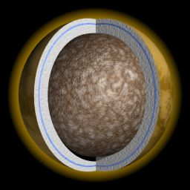
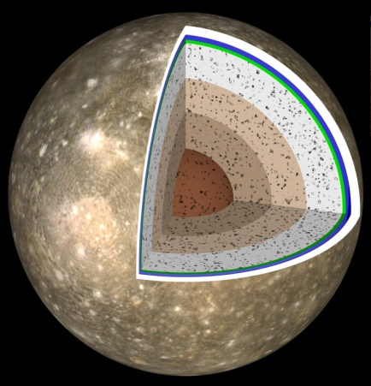
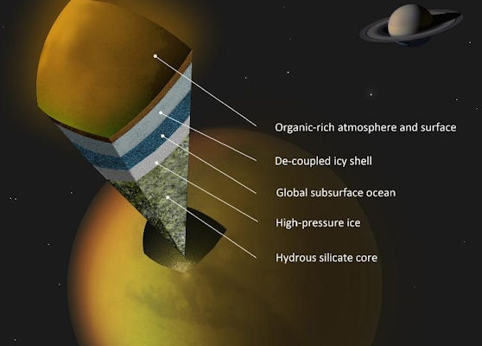
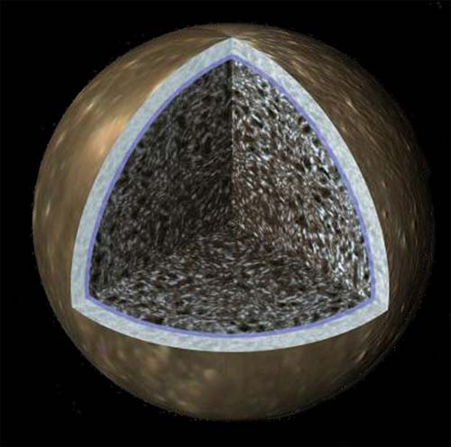
Models of Titan and Callisto.
Callisto:
Titan:
Grasset et al., 2005
Mitri et al., 2009
Sohl F. et al., 2003
Wilson L., 2002
Sohl F., 2010
Callisto’s general image from NASA, JPL
Titan’s general image from NASA

Slide 4
The initial data for modeling, problem setting
and methods of solution
Physical characteristics of satellites:
- Pressure and temperature at the surface, P[bar] , T [K];
- Gravity acceleration, [m/s²];
- Radius, R [km]
- Average density, g/cm³
- Mass, M [kg]
- Normalized moment of inertia, I/MR²
Models of the satellites internal structure described by the system of following equations:
Equations of hydrostatic equilibrium:
,
The equations of the satellites mass and moment of inertia:
,
The equation for calculating ice component concentration in mantle:
High-pressure water ices equations of state.
density of the water-ice shell,
average density of ice in mantle,
density of the rock–iron component,
average density of mantle
= 3.15 - 3.62 g/cm³ (LL-chondrites)

Slide 5
Comparison of Callisto and Titan.
 | Callisto | Titan
T_{surf.}, K | 110 | 93
M,10²⁴g | 107.6 | 134.6
ρ, g/cm³ | 1.8344 | 1.881
R_{P} | 26.4 | 20.25
R, km | 2410.3 | 2575.0
I/MR² | 0.3549 | 0.3414
H(ice), km | 330 | 520
Rcore, km | 1280 | 1490
H₂O, wt% | 47.6-53.8 | 45.1-51.6
Similar characteristic parameters of Callisto and Titan suggest that satellites could be built from the identical material and have a similar water/rock ratio (being close to 1).

Slide 6
Water content and density gradients in large icy satellites of Jupiter and Saturn.

Slide 7
The total content of water in Callisto and Titan
The blue outline is the model of Titan and the black outline is the model of Callisto.
The specks show the range of parameters in which the same content of H₂O in satellites is possible.
The solid and dotted lines within the contours are the lines of the satellites water-ice crust equal thickness (indicated by numbers, in km).

Slide 8
The internal structure of Titan and Callisto.
“Is Titan just Callisto with weather?”(c) J. Moore
Callisto and Titan located in different planetary systems have similar physical characteristics and the same internal structure.
Thus, they can be considered as space satellites-twins.

Slide 9
Conclusion.
Titan and Callisto are partially differentiated satellites, consisting, in general, of an outer ice shell, rock-ice mantle and rock-iron core.
The satellites do not differ in terms of bulk water content which in average is about 50 wt.%.
The satellites differ just a little from each other in density of rock-iron component composing of their inner regions. The density of the satellites’ rock material is in the range of 3.15 - 3.36 g/cm³, which is typical for the hydrated L/LL chondrites.
The equal content of bulk H₂O and the same density of the satellites’ rock material allow to have assumption that ice and rock-icy planetesimals, with the similar ice and rock composition, were captured into accretion disks of Jupiter and Saturn, and from this material the satellites of outer planet zone Titan and Callisto were formed.

